Slide 1
Invasive Whitefly Pests of Florida
Notes:
Scripted presentation #1: For use mainly by extension personnel and other educators of landscape and pesticide companies to deliver information to professionally licensed landscape and ornamental pesticide applicators. There is additional information on each slide that may not be shown in the online script of the e-learning training module that the trainees will see. The information provided here is for the benefit of Extension Faculty that might want more information to provide their stakeholders.
For decades, Florida has experienced repeated invasions of whitefly species. In this presentation, we will be discussing whiteflies that are recently established into Florida’s landscape. Newly introduced whitefly species may be especially troublesome because they do not have the natural predators, diseases, parasites and parasitoids that helped control them in their native environment and there is often little or no information on these pests in their native countries.

Slide 2
Outline
General Whitefly Introduction
Other Problems with Whiteflies in Florida
Bondar’s Nesting Whitefly
Ficus Whitefly
Rugose Spiraling Whitefly
Monitoring Whiteflies
Managing Whiteflies
Notes:
The purpose of this presentation is to provide educators of professional applicators in the landscape and ornamental industry with the latest information regarding:
a general introduction of whiteflies and relevant previous whitefly problems in Florida
the latest status information on three current invasive pests—Bondar’s Nesting Whitefly (Paraleyrodes bondari), Ficus Whitefly (Singhiella simplex) and Rugose Spiraling Whitefly (Aleurodicus rugioperculatus)
Monitoring of these species includes scouting and proper identification. We will especially emphasize the importance of correct species identification for whitefly pests. Frequently, exotic species remain undetected in generalized integrated pest management programs. While the above three species are currently attracting the most attention, additional species introductions remain a possibility due to Florida’s tropical to subtropical climate and global trade and travel patterns.
Management of these species requires several methods such as cultural, biological and chemical control. It is important to note that in some cases, multiple whitefly species may be infesting a host plant simultaneously, which further enhances either the direct (feeding) or indirect (sooty mold growth caused by honeydew production) damage. In addition, because it is difficult to tell current infestations from previous infestations, we will emphasize how to tell if an infestation has already been parasitized by biocontrol agents which should negate the use of chemicals as the infestation has already been controlled.

Slide 3
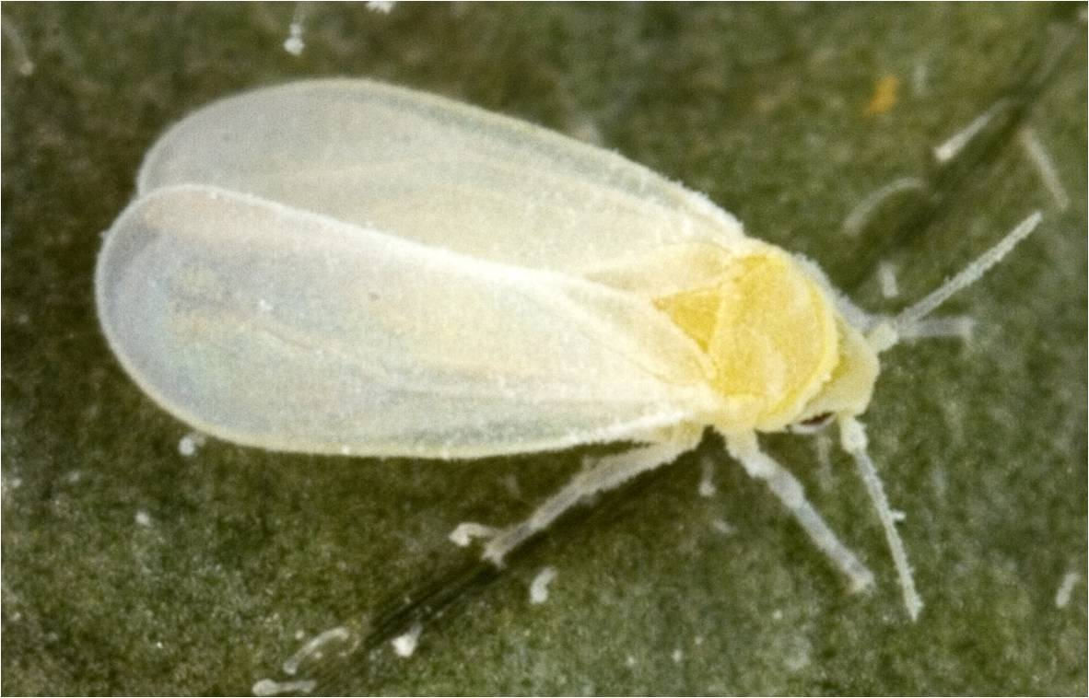
Overview of Whiteflies
1500 species worldwide, at least 60 have been reported from Florida
Small in size and resemble tiny moths
2 pairs of wings which are covered by a white dust or waxy powder
Feed on plant juices with a piercing, sucking mouthpart
Can be a vector of plant diseases
Image credits:
David Cappaert, Michigan State University, www.bugwood.org, #5351016
Notes:
The common name whitefly refers to one family within the Hemiptera–the Aleyrodidae. Unlike other members of the insect order Hemiptera, such as scale insects and mealybugs, adult males and females resemble each other, at least at the field screening level. Of the 1500 known whitefly species worldwide, at least 60 have been reported from Florida. The greatest whitefly abundance occurs in tropical and subtropical areas, and many species are considered either occasional or serious plant pests, but may become major pests in nursery and greenhouse production.
Adult whiteflies have two pairs of wings (the first pair is referred to as the forewings and the back pair is referred to as the hind wings). All wings are approximately the same size. During feeding or while resting on plant material, wings are usually held in a horizontal position over the body (such as in the image above). Whiteflies may be confused with tiny, powdery moths, since a white, dusty or waxy powder covers the wings. In heavy infestations, clouds of flying whitefly adults may be apparent when the host plant is shaken or disturbed. Whitefly size is variable, but adults are generally no more than 1/8in (or 3mm) in size. All life stages (eggs, nymphs, puparia, and adults) may be visible on plant material.
Whiteflies have piercing, sucking mouthparts. These straw-like mouthparts pierce plant leaves and suck sap. Most species feed and reproduce on many host plants (polyphagous). Some species, however, will limit their host range to only a few species.
All whiteflies cause direct feeding damage. Chlorosis, or yellowing of leaves, may be a sign that a large number of whiteflies are feeding on the host. Some whitefly species are also capable of transmitting plant diseases such as tomato yellow leaf curl virus, squash leaf curl, cotton leaf crumple, and tomato necrotic dwarf.
Information sources:
Borrer, D.J. and R.E. White. 1970. Peterson Field Guide to Insects. Houghton Mifflin Co., New York.
Borrer, D.J., C.A. Triplehorn, N.F. Johnson. 1989. An Introduction to Insects. Sixth Edition. Saunders College Publishing. New York.
Hodges. G.S. and G.A. Evans. 2005. “An Identification Guide to the Whiteflies (Hemiptera: Aleyrodidae) of the Southeastern United States”. Florida Entomologist, Volume 88, issue 4, pp. 518-534.
Hodges, G.S., Florida Department of Agriculture and Consumer Services, Division of Plant Industry. Personal Communication. greg.hodges@freshfromflorida.com
Natwick, E.T. and F. F. Laemmlen. 1993. “Protection from Phytophagous Insects and Virus Vectors in Honeydew Melons Using Row Covers”. Florida Entomologist, vol. 76, no. 1, pp. 120-126.
accessed 4/2/2012-
http://www.jstor.org/stable/3496020?seq=1
Stocks, I.C., Florida Department of Agriculture and Consumer Services, Division of Plant Industry. Personal Communication. ian.stocks@freshfromflorida.com

Slide 4
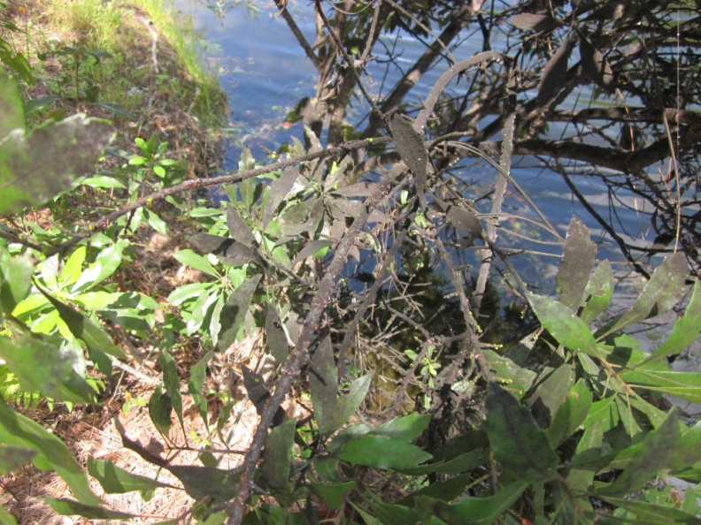
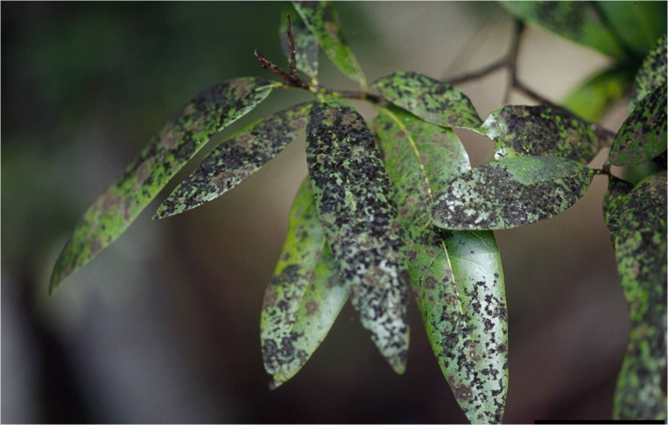
Overview of Whiteflies
Whiteflies may produce honeydew as a by-product of feeding
The presence of sooty mold and/or ants may indicate an infestation
Image credits:
Left – Stephanie Stocks, Department of Entomology and Nematology, University of Florida
Right - Joseph O'Brien, USDA Forest Service, www.bugwood.org, #1427010
Notes:
Many plant feeding hemipterans also produce a sugary waste product called honeydew that they eject while feeding, which then contaminates surrounding plant foliage and other surfaces. The honeydew is colonized by several species of fungus, called sooty molds, which grow into a gray to black mat over the leaves and bark (as seen in the photos above). Sooty mold interferes with photosynthesis and water balance, and contributes to the overall decline of the infested plant. Direct feeding damage may result in plants with a stunted appearance, yellowing of the leaves, dry or dead leaves, and early leaf drop. For landscape ornamental plants, the aesthetic value of a host plant may be severely affected, and honeydew contamination may spread to cars, homes, walkways, outdoor furniture and pools.
Whiteflies are not the only hemipteran insects that produce honeydew–soft scales and aphids also produce large quantities of this waste product. In species that produce honeydew, immatures may have ants that ‘tend’, or protect, them from predators and/or parasites. A similar relationship occurs between ants and aphids, and ants and scale insects. Additionally, wasps and bees may be seen collecting honeydew from any of the hemipteran honeydew producing insects.
Information sources:
Borrer, D.J. and R.E. White. 1970. Peterson Field Guide to Insects. Houghton Mifflin Co., New York.
Borrer, D.J., C.A. Triplehorn, N.F. Johnson. 1989. An Introduction to Insects. Sixth Edition. Saunders College Publishing. New York.
Hodges. G.S. and G.A. Evans. 2005. “An Identification Guide to the Whiteflies (Hemiptera: Aleyrodidae) of the Southeastern United States”. Florida Entomologist, Volume 88, issue 4, pp. 518-534.
Hodges, G.S., Florida Department of Agriculture and Consumer Services, Division of Plant Industry. Personal Communication. greg.hodges@freshfromflorida.com
Stocks, I.C., Florida Department of Agriculture and Consumer Services, Division of Plant Industry. Personal Communication. ian.stocks@freshfromflorida.com

Slide 5
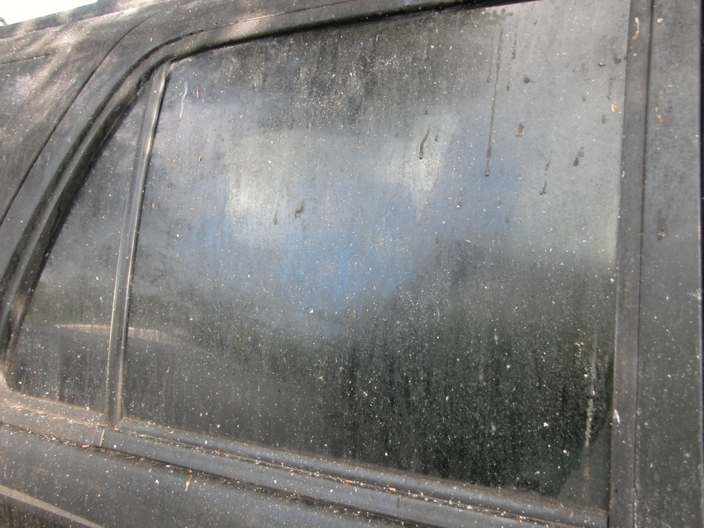
Overview of Whiteflies
Honeydew and sooty mold can cover non-plant surfaces from nearby infested plants
Image credits:
Left – K. Gabel, UF/IFAS Monroe County Extension
Right – H. Glenn, UF/IFAS Tropical Research and Education Center
Notes:
Honeydew and sooty mold occurs on non-plant surfaces as well, especially if those surfaces are located under or near host plants infested by insects that make honeydew.

Slide 6
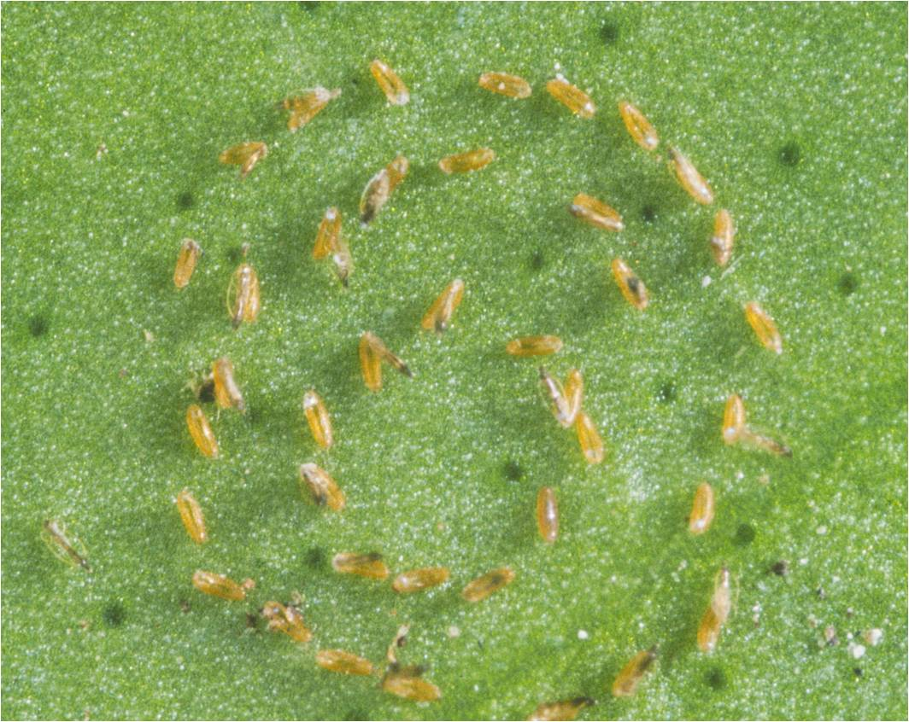
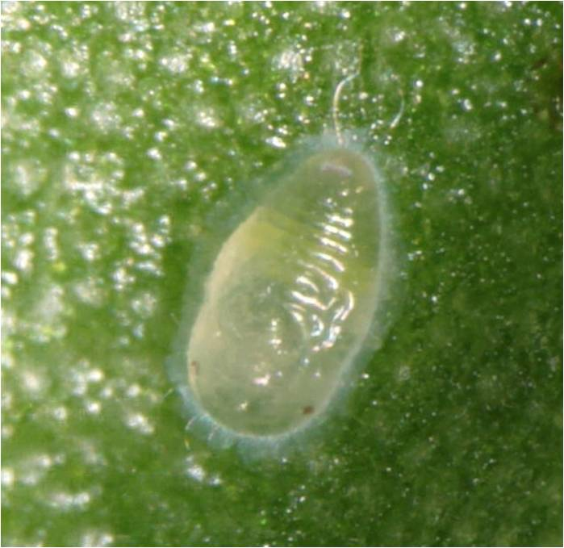
Typical Whitefly Life Cycle
Whitefly adults
2-3 weeks or longer
Puparia or pupae
5-6 days
Eggs
5-6 days
Eggs
Nymphs
5-6 days
Nymph
Image credits:
Whitefly eggs - Florida Department of Agriculture and Consumer Services, Division of Plant Industry
Whitefly nymph - Charles Olsen, USDA APHIS PPQ, www.bugwood.org, #5165041
Notes:
Whiteflies have continuous and overlapping generations throughout the year in tropic and subtropical climates, with development taking longer at cooler temperatures.
The eggs are usually attached to the undersides of leaves by way of a stalk that varies in length. Some species lays the eggs in semicircular or circular rows, while others scatter their eggs over the leaf. Some eggs lay on the leaf surface while others stand on end. The egg surface itself can be smooth or textured.
When the young hatch, the first instar (before the first molt), which is called the crawler, is active and searches for a feeding spot. Post-crawler nymphal instars are sessile and resemble scale insects (Hemiptera: Coccoidea). There are 4 instars with the fourth one often called a puparium or pupa which is not considered a true pupal stage.
The puparium (or pupa) is typically the most morphologically distinctive stage, and is the stage used for identification, which is in contrast to most insects, in which the adult male or female is the most distinctive stage. This stage must be slide-mounted for species identification.
Immatures and puparia (or pupae) range from colorless to a translucent yellow-green to brown or black in color.
Information sources:
Borrer, D.J. and R.E. White. 1970. Peterson Field Guide to Insects. Houghton Mifflin Co., New York.
Borrer, D.J., C.A. Triplehorn, N.F. Johnson. 1989. An Introduction to Insects. Sixth Edition. Saunders College Publishing. New York.
Bohmfalk, G.T., R.E. Frisbie, W. L. Sterling, R.B. Metzer, and A.E. Knutson. 2011. Identification, Biology, and Sampling of cotton insects. Texas AgriLife Extension.
accessed 3/19/2012 –
http://www.soilcropandmore.info/crops/CottonInformation/insect/B-933/b-933.htm
Hodges. G.S. and G.A. Evans. 2005. “An Identification Guide to the Whiteflies (Hemiptera: Aleyrodidae) of the Southeastern United States”. Florida Entomologist, Volume 88, issue 4, pp. 518-534.
Hodges, G.S., Florida Department of Agriculture and Consumer Services, Division of Plant Industry. Personal Communication. greg.hodges@freshfromflorida.com
Stocks, I.C., Florida Department of Agriculture and Consumer Services, Division of Plant Industry. Personal Communication. ian.stocks@freshfromflorida.com

Slide 7
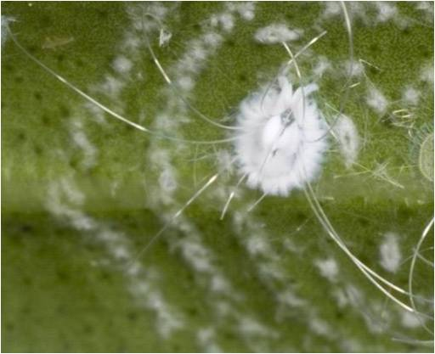
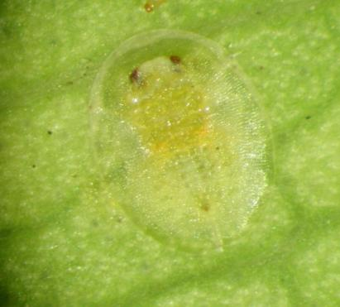
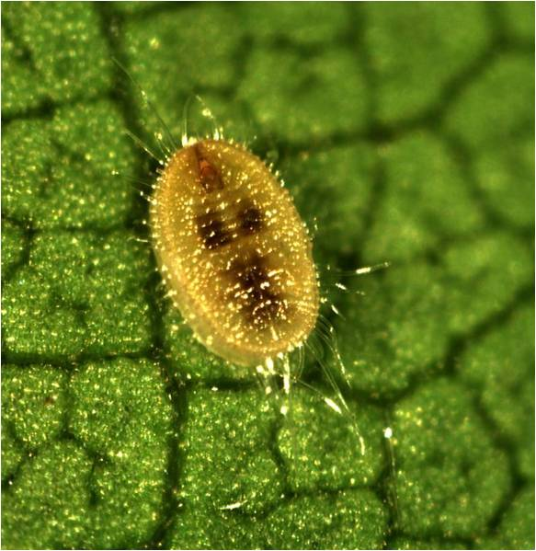
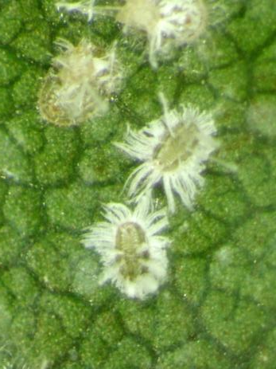
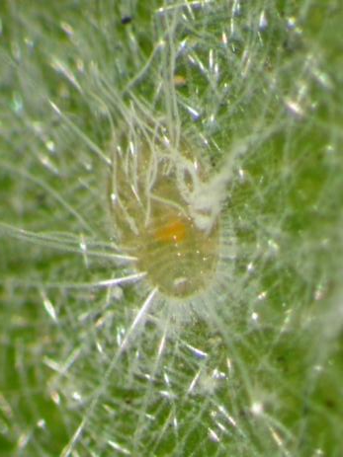
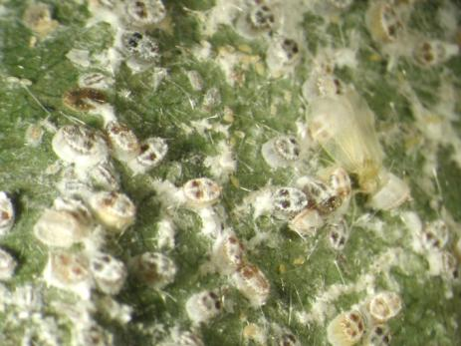
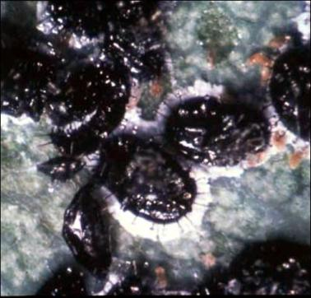
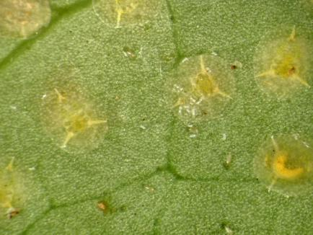
Variability in Nymphal Stages
Image credits:
Top left - David Cappaert, Michigan State University, www.bugwood.org, #5389025
Top middle - Nancy Gregory, University of Delaware, www.bugwood.org, #5427652
All others - H. Glenn, UF/IFAS, Tropical Research and Education Center
Notes:
Nymphs vary in color depending upon the species. Different species also vary in shape from circular, to oval, to elongate. They may be nearly flat or somewhat dome-shaped, and may be smooth or have spine-like projections which can be short or long.
In species that produce wax, they usually produce a fringe of wax around the margin of the body. This fringe can be short or long and can be dull or shiny white in color. Many species also produce elaborate wax patterns on the dorsal surface.
In the field, the puparium (or pupa) is typically the most distinctive stage for screening and tentative identification. Scout for puparia (or pupae) by inspecting the underside of plant material.
Information citation:
Hodges, G.S., Florida Department of Agriculture and Consumer Services, Division of Plant Industry. Personal Communication. greg.hodges@freshfromflorida.com
Stocks, I.C., Florida Department of Agriculture and Consumer Services, Division of Plant Industry. Personal Communication. ian.stocks@freshfromflorida.com

Slide 8
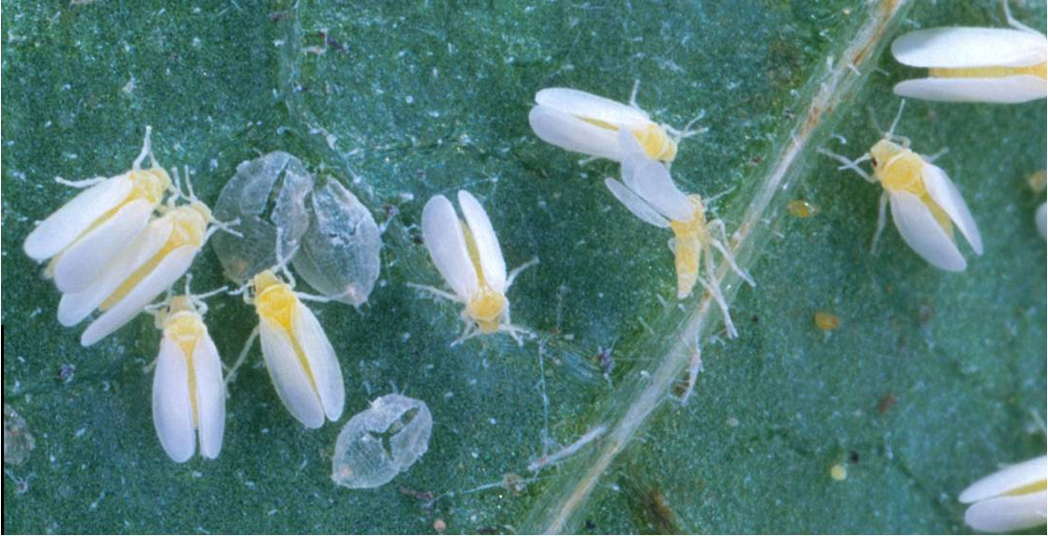
Other Problems with Whiteflies in Florida
Silverleaf Whitefly - Bemisia tabaci
Adults
Image credits:
Scott Bauer, USDA Agricultural Research Service, www.bugwood.org. #1316008
Notes:
Examples of other species of economic concern for Florida include: the silverleaf whitefly (Bemesia tabaci), the citrus whitefly (Dialeurodes citri), and the giant whitefly (Aleurodicus dugesii).
The silverleaf whitefly is found in tropical and warm temperate regions of the world. In the United States, it is found throughout the southeast and in parts of California and Arizona (though it has been found infesting greenhouses in more northern latitudes in the United States and Canada). It is widely distributed throughout the Caribbean Islands, Central and South America, and Mexico. It is also present in parts of Asia, the Middle East, Africa, Europe, and Australia. It is a known pest of over 500 species of plants in at least 63 families, including okra, cauliflower, broccoli, chrysanthemums, poinsettias, African daisies, tomatoes, sweet potatoes, and beans. It was noted in the literature in the late 1800s, but did not become an economically important pest until 1986.
Direct feeding damage caused by this species includes leaf yellowing, leaf wilt, leaf curling, leaf drop, and overall plant health decline. Signs of a silverleaf whitefly infestation may also include the presence of sooty mold and insect-vectored plant viruses.
The adult is a little over 1/32in or 1mm in length with the male being slightly smaller than the female. The body and wings are white to slightly yellowish in color.
Information sources:
CABI. 2012. Bemisia tabaci. Invasive Species Compendium.
accessed 2/27/2012 –
http://www.cabi.org/isc/?compid=5&dsid=8927&loadmodule=datasheet&page=481&site=144
Hodges, G. 1996. Bemisia tabaci (Gennadius) (biotype ‘Q’): A potential new biotype for Florida’s vegetable and ornamental crops. (Hemiptera: Aleyrodidae). FDCAS-DPI pest Alert.
accessed 2/27/2012 –
http://www.freshfromflorida.com/pi/pest-alerts/bemisia-tabaci.html
McAuslane, H. 2009. sweetpotato whitefly Bemisia tabaci. UF Featured Creatures.
accessed 2/28/2012 –
http://entnemdept.ufl.edu/creatures/veg/leaf/silverleaf_whitefly.htm

Slide 9
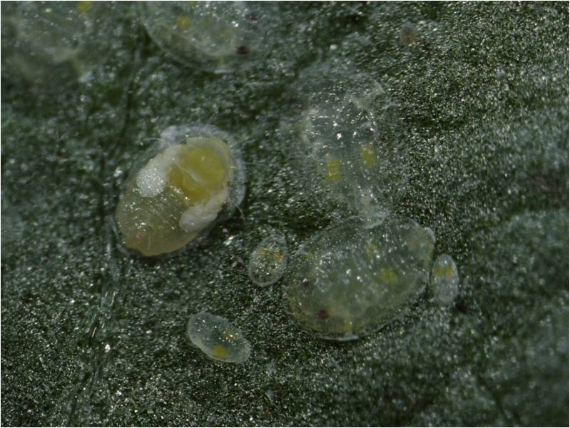
Other Problems with Whiteflies in Florida
Silverleaf Whitefly - Bemisia tabaci
Nymphs
Image credits:
Lance Osborne, UF/IFAS, Mid-Florida Research and Education Center
Notes:
Nymphs of the silverleaf whitefly are scale-like measuring 1/32in or 0.7mm in length at pupation. Puparium (or pupa) are flat, and somewhat oval in shape (though it is an irregular oval).
This pest is currently managed by several tiny, parasitic wasps: Encarsia pergandiella, E. transvena, E. nigricephala and several species of Eretmocerus (which are common throughout the state).
It may also be known as the sweet potato whitefly and tobacco whitefly. This was a pest in the past for Florida and may become one again in the future due to insecticide resistance and associated new population genetics (i.e. biotypes).
Information sources:
CABI. 2012. Bemisia tabaci. Invasive Species Compendium.
accessed 2/27/2012 –
http://www.cabi.org/isc/?compid=5&dsid=8927&loadmodule=datasheet&page=481&site=144
Hodges, G.S. 1996. Bemisia tabaci (Gennadius) (biotype ‘Q’): A potential new biotype for Florida’s vegetable and ornamental crops. (Hemiptera: Aleyrodidae). FDACS-DPI pest Alert.
accessed 2/27/2012 –
http://www.freshfromflorida.com/pi/pest-alerts/bemisia-tabaci.html
McAuslane, H. 2009. Sweetpotato whitefly Bemisia tabaci. UF Featured Creatures.
accessed 2/28/2012 –
http://entnemdept.ufl.edu/creatures/veg/leaf/silverleaf_whitefly.htm

Slide 10
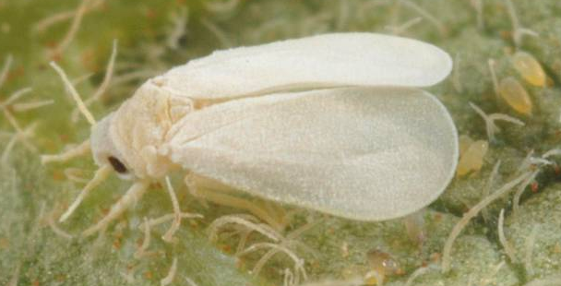
Other Problems with Whiteflies in Florida
Citrus Whitefly - Dialeurodes citri
Adult
Image credits:
Lyle Buss, Department of Entomology and Nematology, University of Florida
Notes:
Citrus whitefly was introduced into Florida between 1858 and 1885 from India to which it is native. It can now be found in parts of Asia, Africa, Central America and the Caribbean, South America, Europe, and North America (in Mexico and the U.S.). In the U.S., it is found in Alabama, California, Colorado, Florida, Georgia, Illinois, Louisiana, Mississippi, North Carolina, South Carolina, Texas, Virginia, and Washington, D.C.
Examples of plant hosts include banana shrub, Boston ivy, jasmine, laurel cherry, crape myrtle, English ivy, Ficus macrophylla, lilac, privet, pomegranate, tree of heaven, water oak, and citrus. This pest causes decline in vigor of the plant and causes the fruit to be small and insipid (without taste). The sooty mold that grows on the fruit and tree as a result of an infestation causes the fruit to delay in coloring and to ripen unevenly (e.g. the bottom part of the fruit may ripen before the top part of the fruit). In addition, the sooty mold provides great cover for secondary infestations of citrus scales.
The adults are 1/8in or 3mm in length and the wings are white with no darkened areas on them.
Information sources:
CABI. 2012. Dialeurodes citri (citrus whitefly). Invasive Species Compendium (beta).
accessed 2/28/2012 –
http://www.cabi.org/isc/?compid=5&dsid=18698&loadmodule=datasheet&page=481&site=144
Fasulo, T.R. and H.V. Weems. 2010. Citrus Whitefly. UF Featured Creatures.
accessed 2/28/2012 –
http://entnemdept.ufl.edu/creatures/citrus/citrus_whitefly.htm

Slide 11
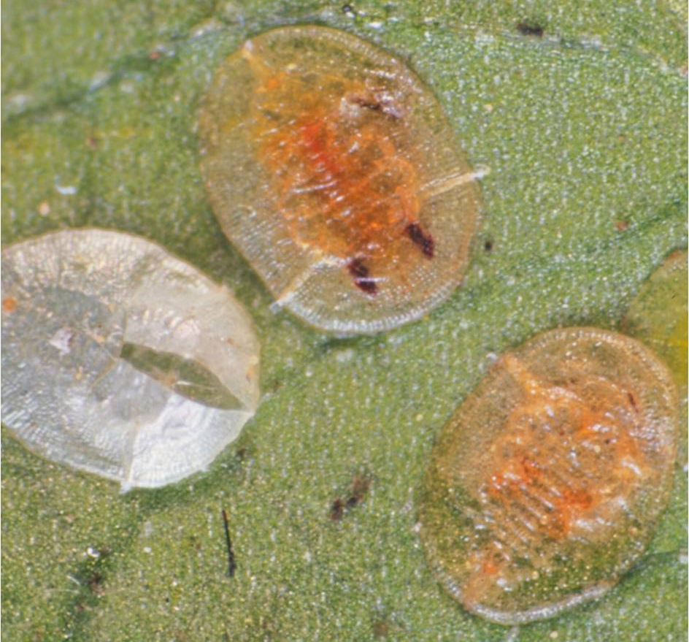
Other Problems with Whiteflies in Florida
Citrus Whitefly - Dialeurodes citri
Nymphs
Image credits:
Florida Department of Agriculture and Consumer Services, Division of Plant Industry
Notes:
The nymphs measure 1/16in or 1.5mm in length and almost 1/16in or 1.2mm in width when ready to pupate. They are translucent in color and flat and elliptical in shape. They produce no waxy fringe along their margins or waxy rods that extend out from the body. They are found on the undersides of the leaf. The length of its life cycle varies from 41 to 333 days depending on temperature.
Several biological control agents were introduced to help manage this pest. A tiny wasp parasitoid, Encarsia lahorensis, is established in Florida's citrus regions and is reducing citrus whitefly populations. A species of beetle, Delphastus catalinae, from California was also introduced (it feeds on whitefly eggs). In addition, two native ladybird beetles, Cycloneda sanguinea and Scymnus punctatus, have been observed to feed on citrus whitefly in Florida, as well as a mirid bug, lacewings, mites, ants, and a species of thrips, Aleurodothrips fasciapennis. A small, brown ladybird beetle, Delphastus pusillus, also native to Florida, feeds on the eggs but does not seem to be that abundant.
Information sources:
CABI. 2012. Dialeurodes citri (citrus whitefly). Invasive Species Compendium (beta).
accessed 2/28/2012 –
http://www.cabi.org/isc/?compid=5&dsid=18698&loadmodule=datasheet&page=481&site=144
Fasulo, T.R. and H.V. Weems. 2010. Citrus Whitefly. UF Featured Creatures.
accessed 2/28/2012 –
http://entnemdept.ufl.edu/creatures/citrus/citrus_whitefly.htm

Slide 12
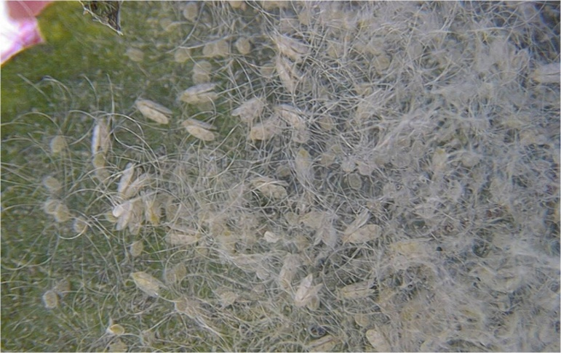
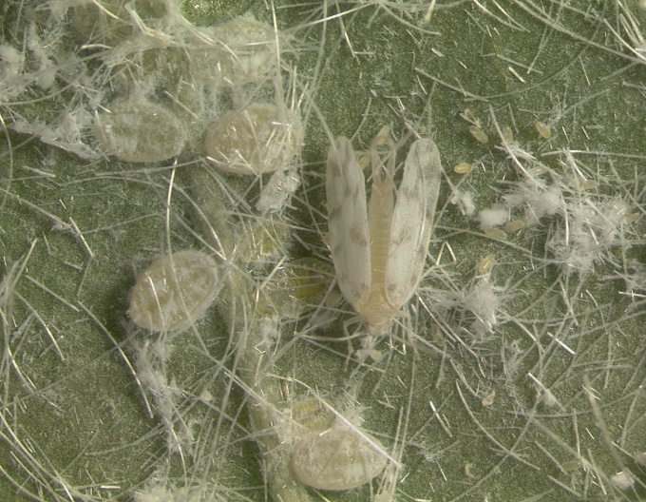
Other Problems with Whiteflies in Florida
Giant Whitefly - Aleurodicus dugesii
Adults
Image credits:
Right – Lyle Buss, Department of Entomology and Nematology, University of Florida
Left- Anne W. Gideon, www.bugwood.org, #1192022
Notes:
The giant whitefly is native to Mexico and Central America (Costa Rica, El Salvador, and Guatemala). It was first detected in the United States in Texas in 1991, then in California in 1992. It was then detected in Louisiana and Florida (Volusia County) in 1996. It has also been found in Arizona, Hawaii and Indonesia.
It was a particular pest of Hibiscus species in Florida; however, in California, it was reported from more than 43 plant genera and 35 plant families. Damage to plants included leaf yellowing, leaf drop, decline in plant growth and sooty mold.
Field specimens of the adult in this genus are quite recognizable in comparison with the other whitefly species currently occurring in the U.S., as it is approximately 1/4in or 5mm in length, much larger than other whitefly species.
Information sources:
Hodges, G.S. 1997. Giant Whitefly, Aleurodicus dugesii Cockerell, in Florida. FDACS-DPI Pest Alert.
accessed 2/25/2012 –
http://www.freshfromflorida.com/pi/pest-alerts/aleurodicus-dugesii.html
Nguyen, R. and A.B. Hamon. Bureau of Methods Development & Biological Control - Biological control of giant whitefly, Aleurodicus dugesii Cockerell, in Florida.
accessed 2/25/2012 –
http://www.freshfromflorida.com/pi/methods/giant-whitefly-bc.html

Slide 13
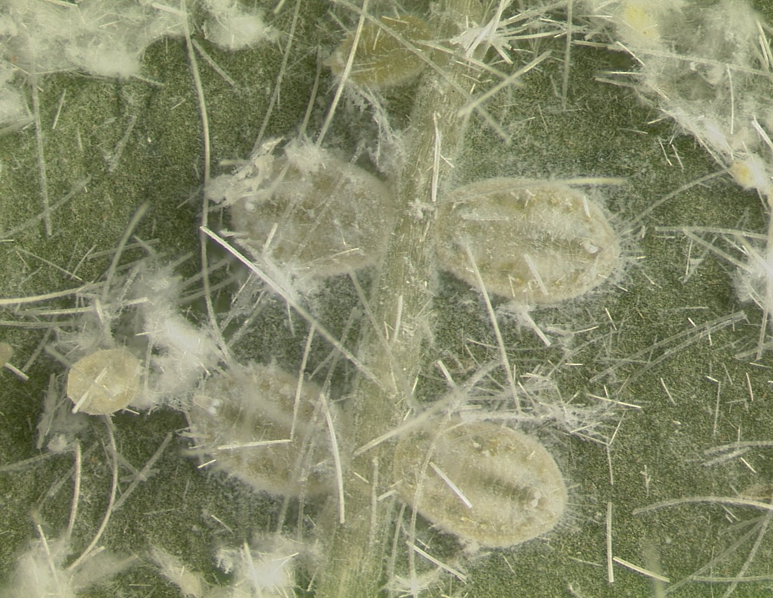
Other Problems with Whiteflies in Florida
Giant whitefly - Aleurodicus dugesii
Eggs and Nymphs
Image credits:
Lyle Buss, Department of Entomology and Nematology, University of Florida
Notes:
Additionally, Aleurodicus females lay their eggs in a spiral pattern. Nymphs produce long, glasslike filaments of wax which can grow up to 10 inches long in the lab (yellow arrows). Under summer conditions in Florida, the life cycle takes between 25-35 days to complete. Multiple and overlapping generations can occur.
It can potentially be found in all Florida counties that is within the hardiness tolerance for hibiscus, though it is not normally common. In 1997, the parasitic wasp Entedononecremnus krauteri was obtained from California, and subsequently reared and released in Seminole, Indian River, St. Lucie and Volusia Counties. Another parasitic wasp, Encarsiella noyesi, also from California, was released in Volusia and Indian River Counties on June 12, 1998.
In follow-up surveys, both parasitoid species, as well as a native Encarsia species, were detected in appreciable numbers and seen to be feeding on the giant whitefly. Since then, these biocontrol agents have been providing adequate management of giant whitefly in Florida.
Information sources:
Hodges, G.S. 1997. Giant Whitefly, Aleurodicus dugesii Cockerell, in Florida. FDACS-DPI Pest Alert.
accessed 2/25/2012 –
http://www.freshfromflorida.com/pi/pest-alerts/aleurodicus-dugesii.html
Nguyen, R. and A.B. Hamon. Bureau of Methods Development & Biological Control - Biological control of giant whitefly, Aleurodicus dugesii Cockerell, in Florida.
accessed 2/25/2012 –
http://www.freshfromflorida.com/pi/methods/giant-whitefly-bc.html

Slide 14
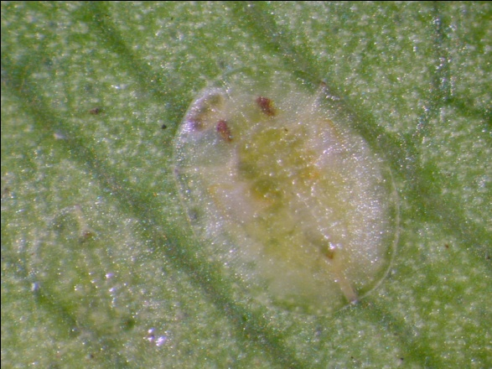
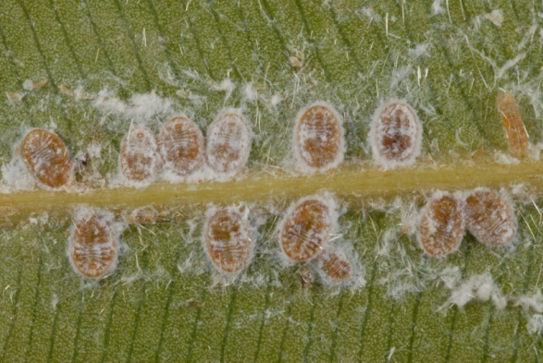
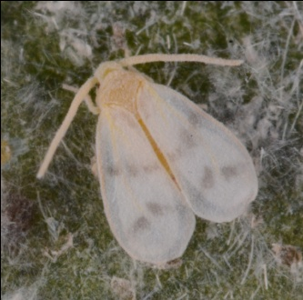
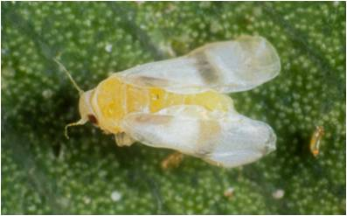
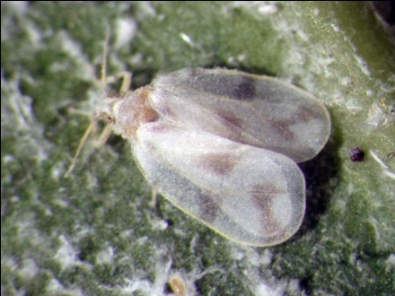
Recent Whitefly Issues in South Florida
Bondar’s Nesting Whitefly
Rugose Spiraling
Whitefly
Ficus Whitefly
Image credits: Bondar’s nesting whitefly: nymph – Ian Stocks, Florida Department of Agriculture and Consumer Services, Division of Plant Industry; adult - Lyle Buss, Department of Entomology and Nematology, University of Florida
Ficus whitefly: nymph – Catharine Mannion, UF/IFAS, UF/IFAS, Tropical Research and Education Center; adult – Jeff Lotz, Florida Department of Agriculture and Consumer Services, Division of Plant Industry
Rugose spiraling whitefly: nymph - Lyle Buss, Department of Entomology and Nematology, University of Florida; adult - H. Glenn, UF/IFAS, Tropical Research and Education Center
Notes:
In this presentation, we will be focusing on three invasive species currently causing problems in south Florida. They are:
Bondar’s Nesting Whitefly - Paraleyrodes bondari
Rugose Spiraling Whitefly - Aleurodicus rugioperculatus
Ficus Whitefly - Singhiella simplex

Slide 15
Bondar’s Nesting Whitefly

Slide 16
Bondar’s Nesting Whitefly Paraleyrodes bondari
Native to South America and the Caribbean
Also detected in Madeira, Comoros, Mauritius, Reunion, Taiwan, Hawaii, Portugal
Reported in Florida in December 2011
Broward
Collier
Lee
Miami-Dade
Palm Beach
Notes:
This pest is native to the new world and was originally described from Brazil, although it also occurs in Belize, Honduras, Venezuela, and Puerto Rico. It has been detected in Madeira (off the west coast of Africa), Comoros, Mauritius and Reunion (off the east coast of Africa), Taiwan, Hawaii, and the United States (in California and Florida).
It was reported in Florida in December 2011, and has since been detected in the following counties: Broward, Collier, Lee, Miami-Dade and Palm Beach.
Information sources:
CABI. 2012. Paraleyrodes bondari. Invasive Species Compendium (Beta).
accessed 2/25/2012 –
http://www.cabi.org/isc/?compid=5&dsid=116127&loadmodule=datasheet&page=481&site=144
Evans, G.A. 2008. The Whiteflies (Hemiptera: Aleyrodidae) of the World and Their Host Plants and Natural Enemies. USDA-APHIS.
accessed 2/26/2012 –
http://www.sel.barc.usda.gov:8080/1WF/World-Whitefly-Catalog.pdf
Hodges, G.S., Florida Department of Agriculture and Consumer Services, Division of Plant Industry. Personal Communication. greg.hodges@freshfromflorida.com
Stocks, I.C. 2012. Bondar’s Nesting Whitefly, Paraleyrodes bondari, a Whitefly (Hemiptera: Aleyrodidae) New to Florida Attacking Ficus and Other Hosts. FDACS-DPI Pest Alert.
accessed 2/25/2012-
http://www.freshfromflorida.com/pi/pest-alerts/pdf/paraleyrodes-bondari.pdf
Stocks, I.C., Florida Department of Agriculture and Consumer Services, Division of Plant Industry. Personal Communication. ian.stocks@freshfromflorida.com

Slide 17
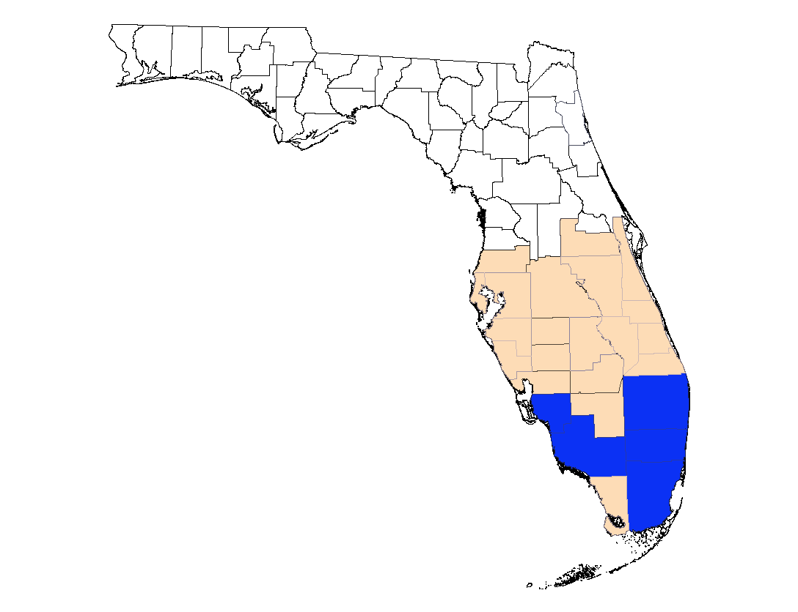
Distribution Map of Bondar’s Nesting Whitefly
Notes:
This map is current as of April 2012. For the most up to date map, please contact Ian Stocks, taxonomic specialist at FDCAS-DPI - ian.stocks@freshfromflorida.com or 352-372-3505 ext. 183.

Slide 18
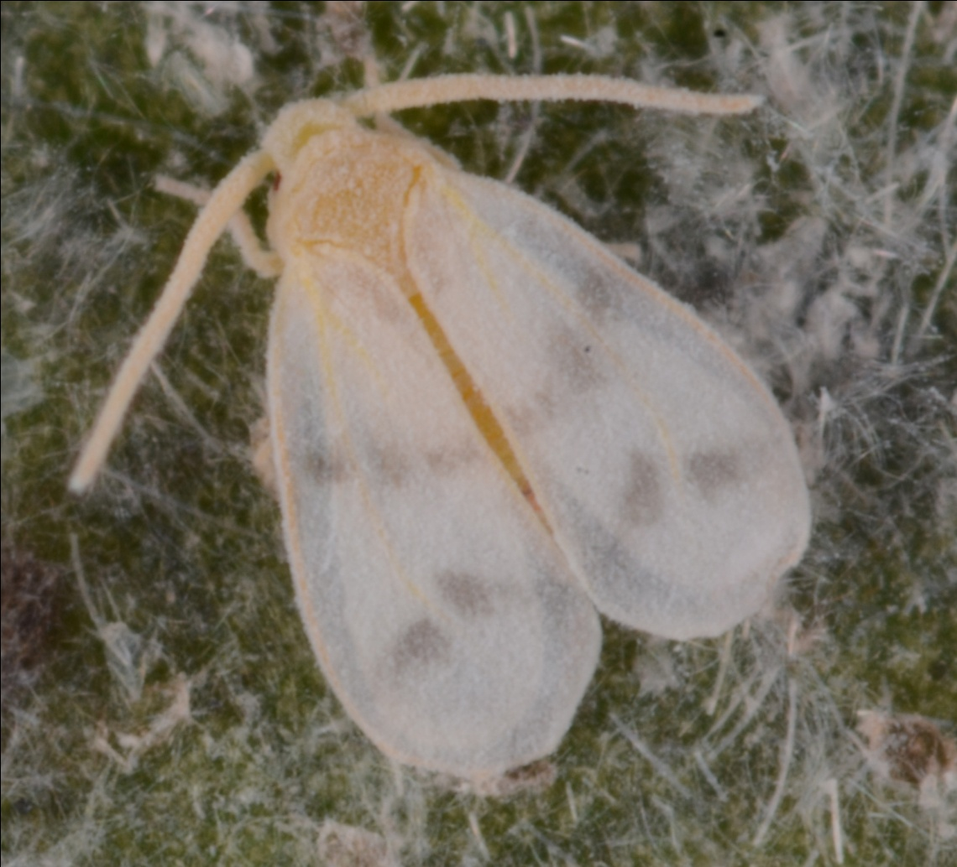
Bondar’s Nesting Whitefly Paraleyrodes bondari
Adult
Image credit:
Lyle Buss, Department of Entomology and Nematology, University of Florida
Notes:
Not much information is known about the biology of this species. It was discovered in Hawaii in 2006, but does not seem to have caused much damage to any plants, even though it occurs widely on planted Hibiscus spp.
The adult is small, a little more than 1/32in or 1mm in length. Two dark bands occur across the white wings (yellow arrows).
You can find adults all over the plant.
Information sources:
Hodges, G.S. 2012 Florida Department of Agriculture and Consumer Services, Division of Plant Industry. Personal Communication. greg.hodges@freshfromflorida.com
Stocks, I.C. 2012. Bondar’s Nesting Whitefly, Paraleyrodes bondari, a Whitefly (Hemiptera: Aleyrodidae) New to Florida Attacking Ficus and Other Hosts. FDACS-DPI Pest Alert.
accessed 2/25/2012-
http://www.freshfromflorida.com/pi/pest-alerts/pdf/paraleyrodes-bondari.pdf
Stocks, I.C. 2012. Florida Department of Agriculture and Consumer Services, Division of Plant Industry. Personal Communication. ian.stocks@freshfromflorida.com

Slide 19
Bondar’s Nesting Whitefly Paraleyrodes bondari
Nymph
Image credit:
Ian Stocks, Florida Department of Agriculture and Consumer Services, Division of Plant Industry
Notes:
The nymphs grow to be a little more than 1/32in or 1mm in length, are oval in shape, and translucent yellow in color. The margin of the nymph is outlined with a narrow band of clear wax. They also have long, white, shiny, fiberglass-like waxy strands projecting from the top of their body (yellow arrows). There are two of these projections at the head end, and four at the back end. There are two smaller ones located in the middle, but they may not be evident under a hand lens (though you can see them in the image above).
You will typically find the eggs and nymphs on the underside of the leaves, however, they have been observed sometimes on the top of the leaves.
Information sources:
Hodges, G.S. 2012 Florida Department of Agriculture and Consumer Services, Division of Plant Industry. Personal Communication. greg.hodges@freshfromflorida.com
Stocks, I.C. 2012. Bondar’s Nesting Whitefly, Paraleyrodes bondari, a Whitefly (Hemiptera: Aleyrodidae) New to Florida Attacking Ficus and Other Hosts. FDACS-DPI Pest Alert.
accessed 2/25/2012-
http://www.freshfromflorida.com/pi/pest-alerts/pdf/paraleyrodes-bondari.pdf
Stocks, I.C. 2012. Florida Department of Agriculture and Consumer Services, Division of Plant Industry. Personal Communication. ian.stocks@freshfromflorida.com

Slide 20
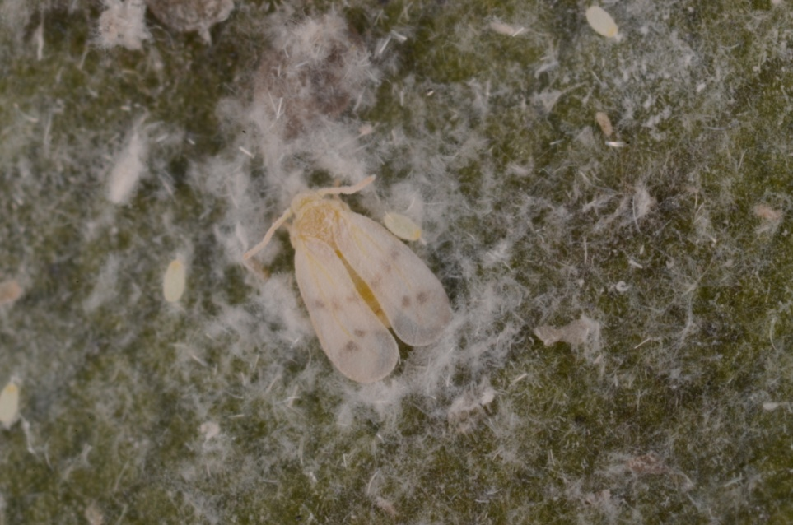
Bondar’s Nesting Whitefly Paraleyrodes bondari
“Nest”
Image credit:
Lyle Buss, Department of Entomology and Nematology, University of Florida
Notes:
Species in this genus are known as the nesting whiteflies, due to the pattern of wax they form on the leaf surface. This circle gradually develops around the nymph and, in some cases, may nearly cover it (yellow arrow).
Information sources:
Hodges, G.S. 2012 Florida Department of Agriculture and Consumer Services, Division of Plant Industry. Personal Communication. greg.hodges@freshfromflorida.com
Stocks, I.C. 2012. Bondar’s Nesting Whitefly, Paraleyrodes bondari, a Whitefly (Hemiptera: Aleyrodidae) New to Florida Attacking Ficus and Other Hosts. FDACS-DPI Pest Alert.
accessed 2/25/2012-
http://www.freshfromflorida.com/pi/pest-alerts/pdf/paraleyrodes-bondari.pdf
Stocks, I.C. 2012. Florida Department of Agriculture and Consumer Services, Division of Plant Industry. Personal Communication. ian.stocks@freshfromflorida.com

Slide 21
Bondar’s Nesting Whitefly Hosts
avocado
banyan tree
canary laurel or barbusano
Chinese hibiscus
coconut palm
guava
Indian laurel
lemon
navel orange
mandarin orange
palms in the genus Chamaedorea
Surinam cherry
sweetsop
sapote
tilo or stinkwood
weeping fig
Notes:
Hosts noted in the literature include:
avocado (Persea americana)
canary laurel or barbusano (Apollonias barbujana)
Chinese hibiscus (Hibiscus rosa-sinensis)
coconut palm (Cocos nucifera)
lemon (Citrus limon)
mandarin orange (C. reticulata)
navel orange (C. sinensis)
palms in the genus Chamaedorea
Surinam cherry (Eugenia uniflora)
sweetsop (Annona squamosa)
Tilo or stinkwood (Ocotea foetens)
According to the DPI database, additional hosts include:
Banyan tree (Ficus benghalensis)
guava (Psidium guajava)
Indian laurel (Ficus microcarpa)
sapote (Pouteria sapota)
weeping fig (Ficus benjamina)
It is currently most reported on the weeping fig (Ficus benjaminia).
In general, in order to be reported as a host, puparia would have to be found on the plant.
Information sources:
Evans, G.A. 2008. The Whiteflies (Hemiptera: Aleyrodidae) of the World and Their Host Plants and Natural Enemies. USDA-APHIS.
accessed 2/26/2012 –
http://www.sel.barc.usda.gov:8080/1WF/World-Whitefly-Catalog.pdf
Martin, J. H. 1996. Neotropical whiteflies of the subfamily Aleurodicinae established in the western Palearctic (Homoptera: Aleyrodidae). Journal of Natural History 30: 1849–1859.
Stocks, I.C. 2012. Bondar’s Nesting Whitefly, Paraleyrodes bondari, a Whitefly (Hemiptera: Aleyrodidae) New to Florida Attacking Ficus and Other Hosts. FDACS-DPI Pest Alert.
accessed 2/25/2012-
http://www.freshfromflorida.com/pi/pest-alerts/pdf/paraleyrodes-bondari.pdf

Slide 22
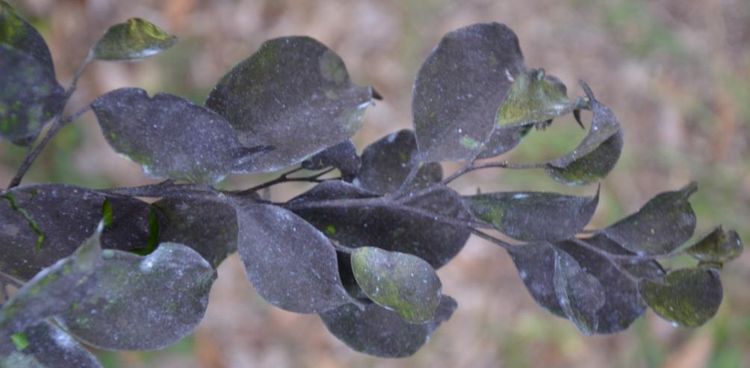
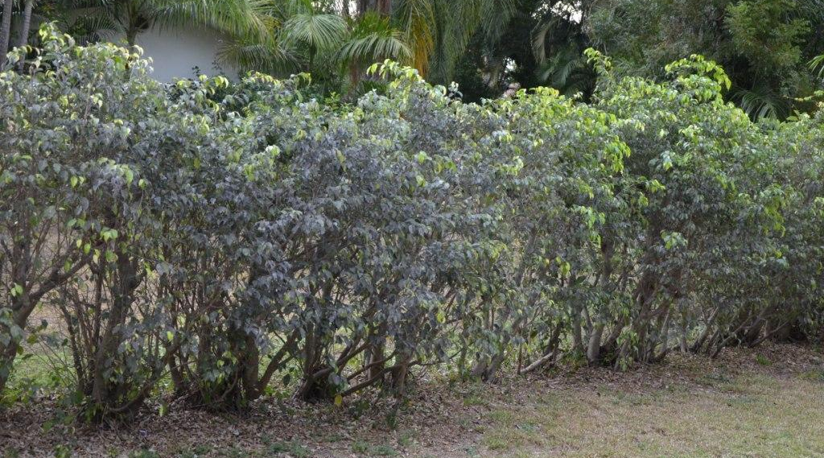
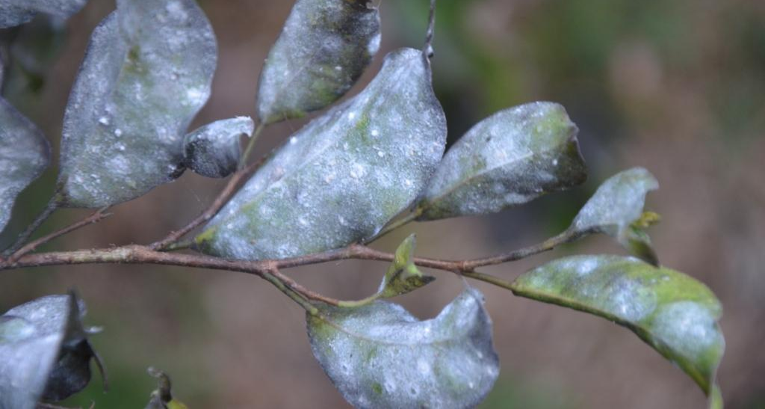
Bondar’s Nesting Whitefly Damage
Top of the leaves →
Bottom of the leaves →
Image credit:
Stephen Brown, UF/IFAS, Lee County Extension
Notes:
Bondar's nesting whitefly has not been reported as causing much damage in Florida to date. Some leaf drop may result in response to plant stress. Current infestation reports have focused on wax, honeydew, and sooty mold that covers the leaves. In Hawaii, where it has also been reported, it is not considered a problem. This suggests that eventually it may not become much of a problem here in Florida either.
Information sources:
Stocks, I.C. 2012. Bondar’s Nesting Whitefly, Paraleyrodes bondari, a Whitefly (Hemiptera: Aleyrodidae) New to Florida Attacking Ficus and Other Hosts. FDACS-DPI Pest Alert.
accessed 2/25/2012-
http://www.freshfromflorida.com/pi/pest-alerts/pdf/paraleyrodes-bondari.pdf

Slide 23
Ficus Whitefly

Slide 24
Ficus Whitefly Singhiella simplex
Native to India, Burma, and China
Where it is a known pest of ficus
Found in Florida in 2007
Detected in 19 counties so far, mostly in southern Florida
Particularly problematic for ficus hedges which are planted in abundance in southern Florida
Notes:
This pest is native to India, Burma, and China where it is a known pest of plants in the Ficus genus.
It was detected in Florida in August 2007 and has since been detected in the following counties: Brevard, Broward, Collier, Highlands, Hillsborough, Indian River, Lee, Manatee, Martin, Miami-Dade, Monroe, Okeechobee, Orange, Osceola, Palm Beach, Pinellas, Sarasota, St. Johns, and St. Lucie.
Information sources:
Evans, G.A. 2008. The Whiteflies (Hemiptera: Aleyrodidae) of the World and Their Host Plants and Natural Enemies. USDA-APHIS.
accessed 2/26/2012 –
http://www.sel.barc.usda.gov:8080/1WF/World-Whitefly-Catalog.pdf
Hodges, G.S. 2007. The Fig Whitefly Singhiella simplex (Singh) (Hemiptera: Aleyrodidae): A New Exotic Whitefly Found on Ficus Species in South Florida. FDACS-DPI Pest Alert.
accessed 2/25/2012-
http://www.freshfromflorida.com/pi/pest-alerts/singhiella-simplex.html
Legaspi, J.C., C. Mannion, D. Amalin, and B.C. Legaspi, Jr. 2011. “Life Table Analysis and Development of Singhiella simplex (Hemiptera: Aleyrodidae) Under Different Constant Temperatures”. Annals of the Entomological Society of America, vol. 104, issue 3, pp. 451-458.
Mannion, C. 2010. Ficus Whitefly – Management in the Landscape.
Accessed 3/8/2012 - http://trec.ifas.ufl.edu/mannion/pdfs/Ficus%20Whitefly%20(Feb2010)%20Fact%20Sheet.pdf
Stocks, I.C. 2012. Florida Department of Agriculture and Consumer Services, Division of Plant Industry. Personal Communication. ian.stocks@freshfromflorida.com

Slide 25
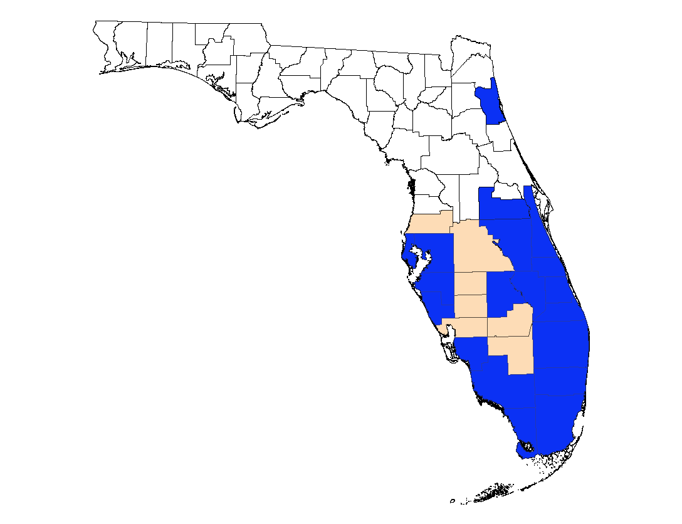
Distribution Map of Ficus Whitefly
Notes:
This map is current as of April 2012. For the most up to date map, please contact Ian Stocks, taxonomic specialist at FDCAS-DPI - ian.stocks@freshfromflorida.com or 352-372-3505 ext. 183.

Slide 26
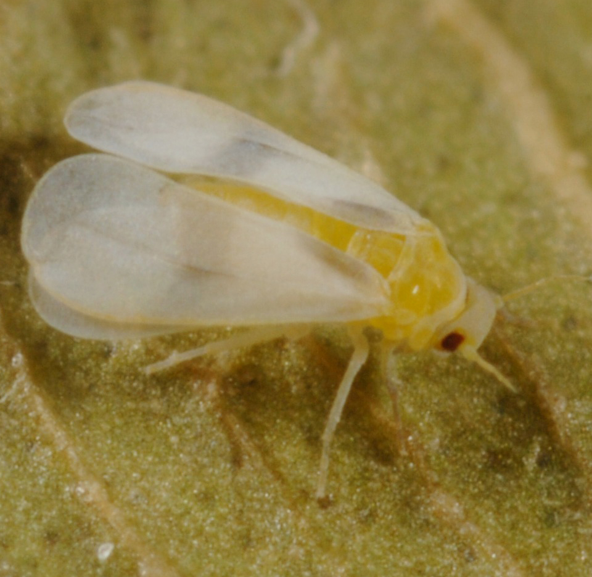
Ficus Whitefly Singhiella simplex
Adult
Image credits:
Image credits:
Lyle Buss, Department of Entomology and Nematology, University of Florida
Notes:
The adult is a little more than 1/16in or 2mm long, and has a yellow body. Its white wings have a faint grey band towards the middle of the wing and on the upper part of each wing (yellow arrows).
Information sources:
Hodges, G.S. 2007. The Fig Whitefly Singhiella simplex (Singh) (Hemiptera: Aleyrodidae): A New Exotic Whitefly Found on Ficus Species in South Florida. FDACS-DPI Pest Alert.
accessed 2/25/2012-
http://www.freshfromflorida.com/pi/pest-alerts/singhiella-simplex.html
Legaspi, J.C., C. Mannion, D. Amalin, and B.C. Legaspi, Jr. 2011. “Life Table Analysis and Development of Singhiella simplex (Hemiptera: Aleyrodidae) Under Different Constant Temperatures”. Annals of the Entomological Society of America, vol. 104, issue 3, pp. 451-458.
Stocks, I.C., Florida Department of Agriculture and Consumer Services, Division of Plant Industry. Personal Communication. ian.stocks@freshfromflorida.com

Slide 27
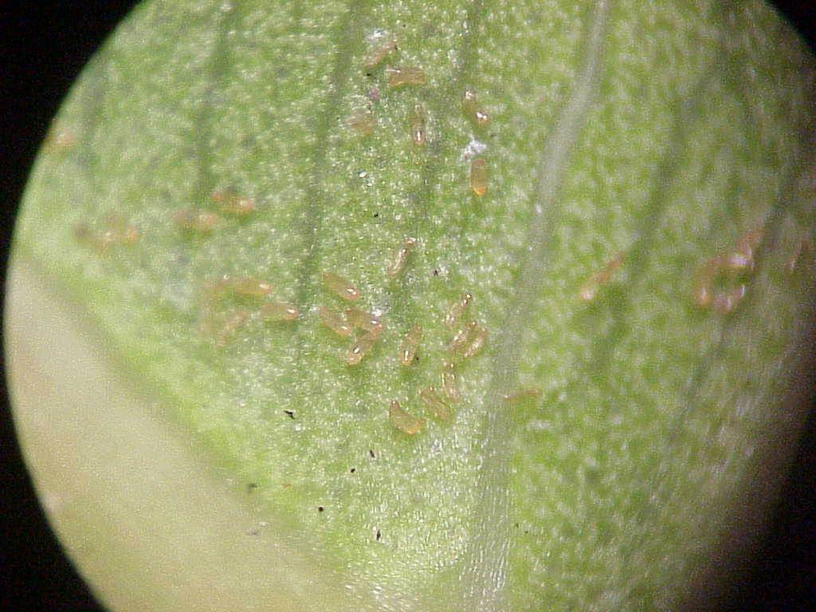
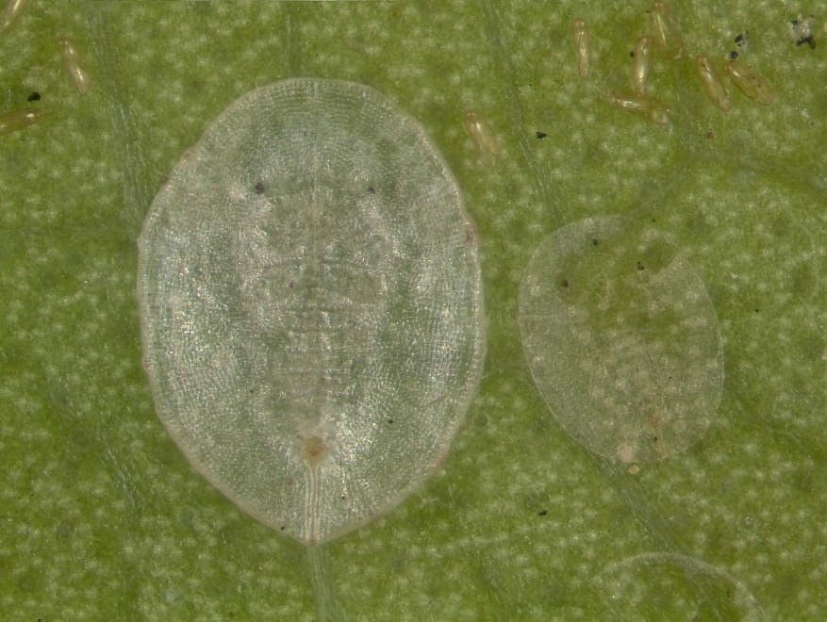
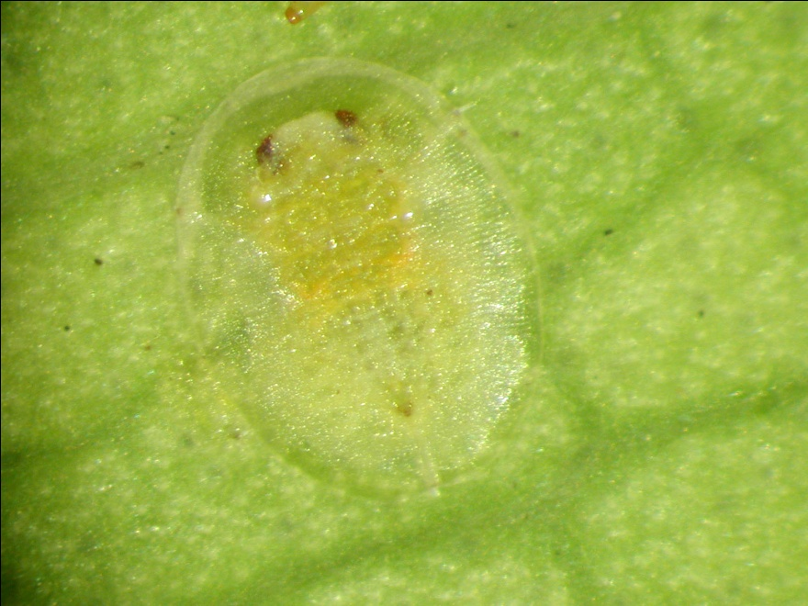
Ficus Whitefly Singhiella simplex
Eggs
Nymphs
Puparium
Image credits:
Image credits:
Egg - A. Hunsberger, UF/IFAS, Urban Horticulture Agent, Miami-Dade County
Nymph – Lyle Buss, Department of Entomology anfd Nematology. University of Florida
Puparium– Catharine Mannion, UF/IFAS, Tropical Research and Education Center
Notes:
Immature stages (eggs, nymphs and puparium or pupa) are located on the underside of the leaves. The eggs are yellow in colo, turning more bronze in color as they age. Eggs are laid at the base of the leaf and along the midvein but, as infestations increase, can be found more spread out on the underside of the leaf.
Nymphs are flat, oval in shape and translucent in color. Mature nymphs and puparia eventually become more convex and visible. They do not produce wax.
The puparium (or pupa) measures just under 1/16in or 1.3mm long and little more than 1/32in or 1mm wide. They are disc-like in shape and have red eyes. The pupal skin that remains after the adult emerges is whitish and papery and can be easily seen during scouting and inspection. However, this is not the best stage to use when making management decisions because the cast skin can remain on the leaf for relatively long periods indicating maybe a past infestation, but not necessarily a current one.
Information sources:
Hodges, G.S. 2007. The Fig Whitefly Singhiella simplex (Singh) (Hemiptera: Aleyrodidae): A New Exotic Whitefly Found on Ficus Species in South Florida. FDACS-DPI Pest Alert.
accessed 2/25/2012-
http://www.freshfromflorida.com/pi/pest-alerts/singhiella-simplex.html
Legaspi, J.C., C. Mannion, D. Amalin, and B.C. Legaspi, Jr. 2011. “Life Table Analysis and Development of Singhiella simplex (Hemiptera: Aleyrodidae) Under Different Constant Temperatures”. Annals of the Entomological Society of America, vol. 104, issue 3, pp. 451-458.
Stocks, I.C., Florida Department of Agriculture and Consumer Services, Division of Plant Industry. Personal Communication. ian.stocks@freshfromflorida.com

Slide 28
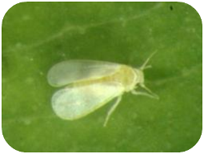
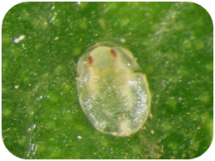
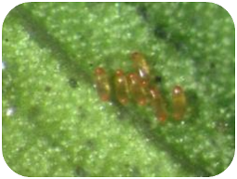
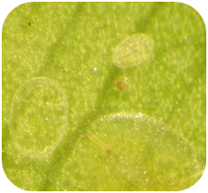
Ficus Whitefly Life Cycle
Adult
2-4 days
Puparia
~6 days
Eggs
~10 days
*2nd
Nymphs
~11 days
Constant temperature (80 ˚ F)
Image credits:
H. Glenn, UF/IFAS, Tropical Research and Education Center
Notes:
The typical life cycle is about 1 month (see diagram above). However, temperature affects development time with a generation taking about 99 days to complete at 59˚F (15˚C) and about 27 days to complete at 86˚F (30˚C).
Information sources:
Legaspi, J.C., C. Mannion, D. Amalin, and B.C. Legaspi, Jr. 2011. “Life Table Analysis and Development of Singhiella simplex (Hemiptera: Aleyrodidae) Under Different Constant Temperatures”. Annals of the Entomological Society of America, vol. 104, issue 3, pp. 451-458.

Slide 29
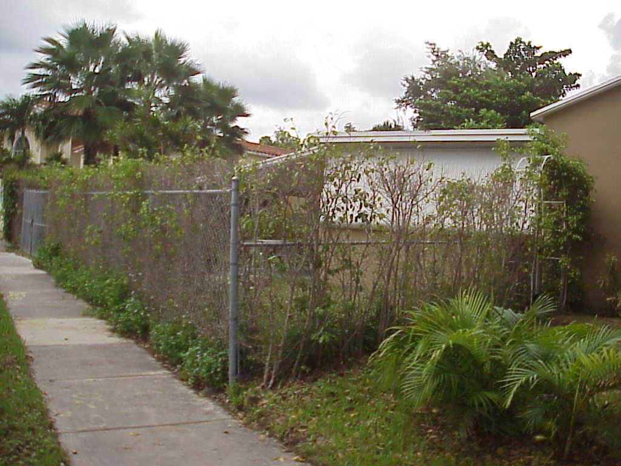
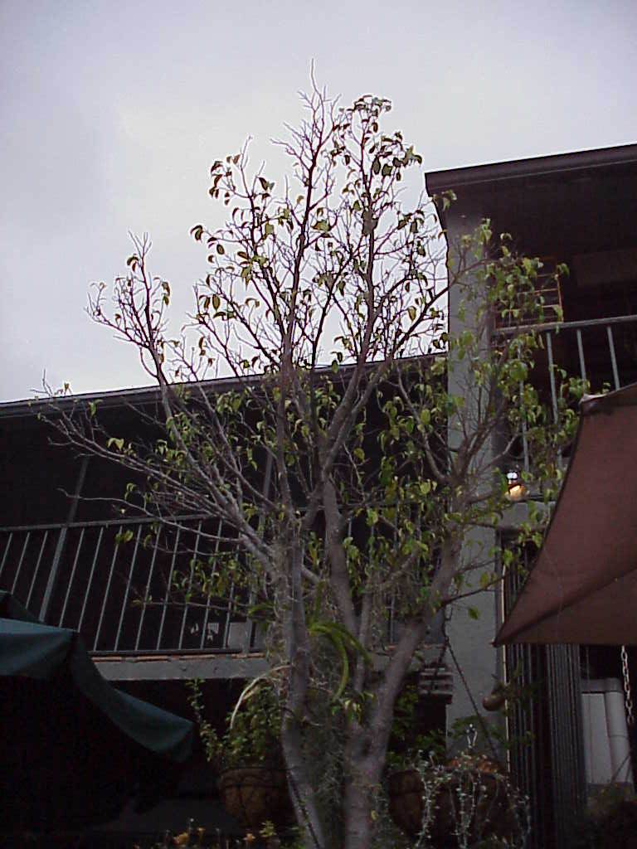
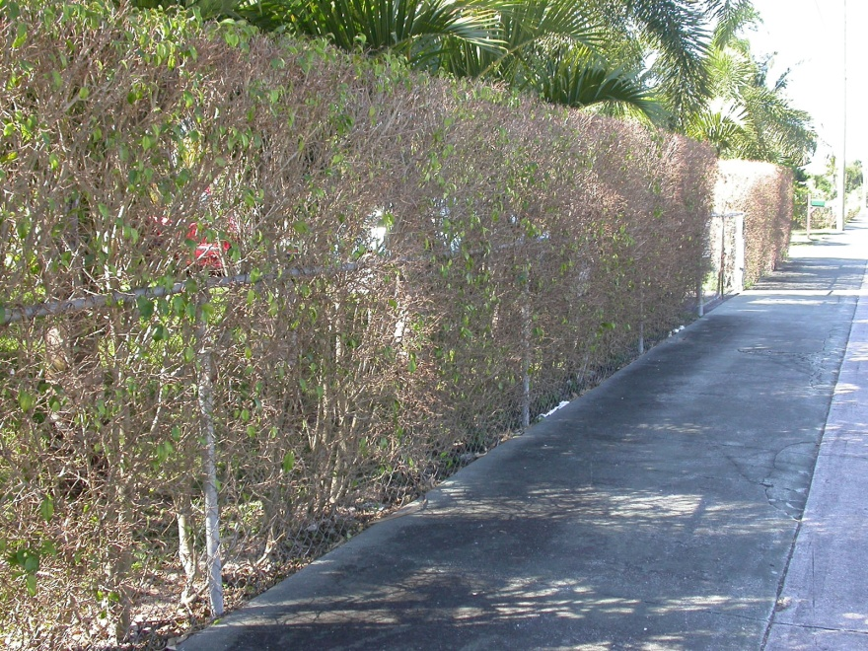
Ficus Whitefly Damage
Image credits:
Left and top right - A. Hunsberger, UF/IFAS, Miami-Dade County Extension
Bottom right – C. Mannion, UF/IFAS, Tropical Research and Education Center
Notes:
Hosts include:
Weeping fig (Ficus benjamina), false banyan tree (F. altissima), banyan tree (F. bengalensis), Cuban laurel (F. microcarpa), strangler fig (F. aurea), Indian fig (F. racemosa), fiddle leaf fig (F. lyrata), and banana leaf fig (F. maclellandii).
Remember, in general, in order to be reported as a host, puparia would have to be found on the plant.
Some ficus species or cultivars do not seem to be susceptible to this pest. Ficus microcarpa (green island) is an example.
Initial damage includes yellowing of leaves. Severe infestations cause leaf drop, branch dieback and defoliation of the plant. Repeated re-growth and defoliation may reduce plant health. Ficus whitefly does not excrete large quantities of honeydew, so sooty mold is not a problem with this species. As this type of damage can be caused by problems other than whiteflies, be sure to verify the presence of an active whitefly infestation before beginning treatment.
Information sources:
Evans, G.A. 2008. The Whiteflies (Hemiptera: Aleyrodidae) of the World and Their Host Plants and Natural Enemies. USDA-APHIS.
accessed 2/26/2012 –
http://www.sel.barc.usda.gov:8080/1WF/World-Whitefly-Catalog.pdf
Hodges, G.S. 2007. The Fig Whitefly Singhiella simplex (Singh) (Hemiptera: Aleyrodidae): A New Exotic Whitefly Found on Ficus Species in South Florida. FDACS-DPI Pest Alert.
accessed 2/25/2012-
http://www.freshfromflorida.com/pi/pest-alerts/singhiella-simplex.html
Legaspi, J.C., C. Mannion, D. Amalin, and B.C. Legaspi, Jr. 2011. “Life Table Analysis and Development of Singhiella simplex (Hemiptera: Aleyrodidae) Under Different Constant Temperatures”. Annals of the Entomological Society of America, vol. 104, issue 3, pp. 451-458.
Stocks, I.C., Florida Department of Agriculture and Consumer Services, Division of Plant Industry. Personal Communication. ian.stocks@freshfromflorida.com

Slide 30
Rugose Spiraling Whitefly

Slide 31
Rugose Spiraling Whitefly Aleurodicus rugioperculatus
Native to Central America
Detected in Florida in 2009 in Miami-Dade County
Expanded to include Broward, Monroe, Indian River, and Polk Counties
Has also been referred to as the gumbo limbo spiraling whitefly.
Notes:
This pest is a native of Central America (Belize, Mexico, and Guatemala). It was detected in Florida in 2009 in Miami-Dade County. It has also been found in Broward, Monroe, Indian River, and Polk Counties (these last two indicate that it may be able to survive in Central Florida).
The officially recognized common name is rugose spiraling whitefly, but in some earlier reports it was known as the gumbo limbo spiraling whitefly.
Information sources:
Evans, G.A. 2008. The Whiteflies (Hemiptera: Aleyrodidae) of the World and Their Host Plants and Natural Enemies. USDA-APHIS.
accessed 2/26/2012 –
http://www.sel.barc.usda.gov:8080/1WF/World-Whitefly-Catalog.pdf
Stocks, I.C. 2012. The Rugose Spiraling Whitefly, Aleurodicus rugioperculatus Martin, a New Exotic Whitefly in South Florida (Hemiptera: Aleyrodidae). FDACS-DPI Pest Alert.
accessed 2/25/2012 –
http://www.freshfromflorida.com/pi/pest-alerts/pdf/aleurodicus-rugioperculatus-pest-alert.pdf
Stocks, I.C., Florida Department of Agriculture and Consumer Services, Division of Plant Industry. Personal Communication. ian.stocks@freshfromflorida.com

Slide 32
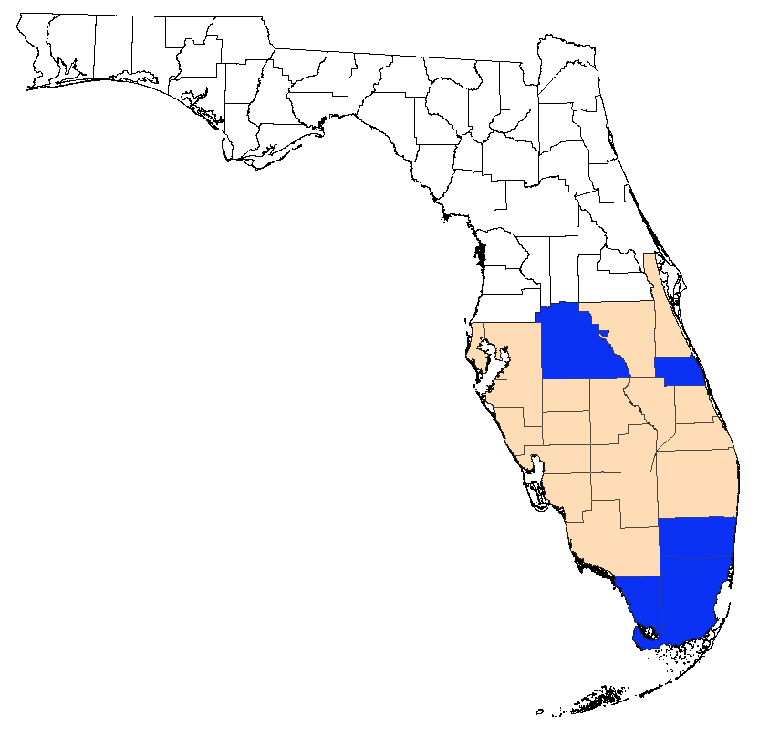
Distribution Map for Rugose Spiraling Whitefly
Notes:
This map is current as of April 2012. For the most up to date map, please contact Ian Stocks, taxonomic specialist at FDCAS-DPI - ian.stocks@freshfromflorida.com or 352-372-3505 ext. 183.

Slide 33
Rugose Spiraling Whitefly Aleurodicus rugioperculatus
Adult
Image credits:
H. Glenn, UF/IFAS, Tropical Research and Education Center
Notes:
Adult wings appear to have four light gray dots located horizontally (red arrow) and with a light gray inverted V-shaped band near the tip of the forewings (yellow arrow). They measure a little less than 1/8in or 2.5mm in length. These whiteflies are comparatively larger than the “typical” whitefly.
Information sources:
Hodges, G.S., Florida Department of Agriculture and Consumer Services, Division of Plant Industry. Personal Communication. greg.hodges@freshfromflorida.com
Stocks, I.C., Florida Department of Agriculture and Consumer Services, Division of Plant Industry. Personal Communication. ian.stocks@freshfromflorida.com

Slide 34
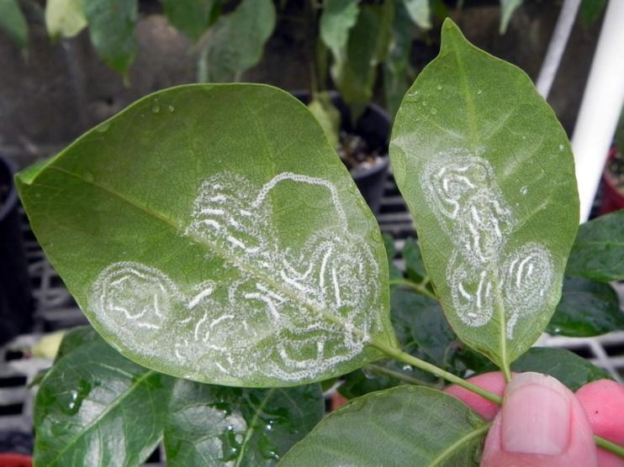
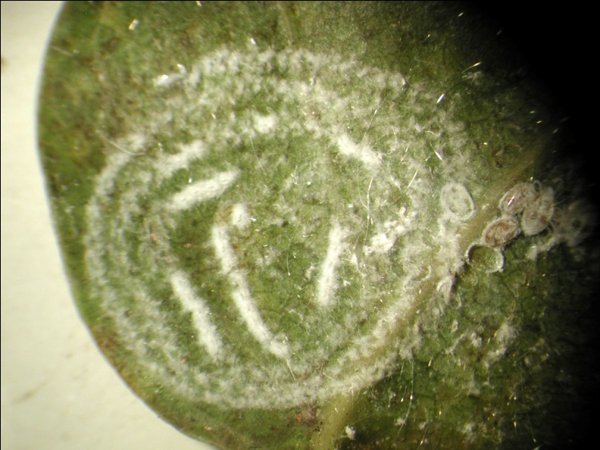
Rugose Spiraling Whitefly Aleurodicus rugioperculatus
Eggs
Image credits:
H. Glenn, UF/IFAS, Tropical Research and Education Center
Notes:
All females of the genus Aleurodicus lay eggs in a spiral-like pattern on the underside of the leaf (yellow arrows). Individual eggs are covered by loose tufts of wax. Females of this species apparently will lay their eggs on plants that are not suitable for development, so evidence of spirals is not proof that the host will be infested. However, numerous plant species do appear to support their development.
Information sources:
Hodges, G.S., Florida Department of Agriculture and Consumer Services, Division of Plant Industry. Personal Communication. greg.hodges@freshfromflorida.com
Stocks, I.C., Florida Department of Agriculture and Consumer Services, Division of Plant Industry. Personal Communication. ian.stocks@freshfromflorida.com

Slide 35
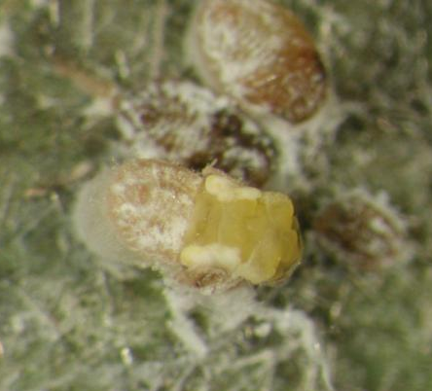
Rugose Spiraling Whitefly Aleurodicus rugioperculatus
Emerging adult
Nymphs
Image credits:
H. Glenn, UF/IFAS, Tropical Research and Education Center
Notes:
Early instars are oval and generally light yellow in color, with a fringe of wax along the margin. In later instars, thin pencils of shiny wax that project from the dorsal surface become more obvious. These occur in all species in this and related genera, but are easily broken off. The number and exact placement of these wax projections varies amongst species, but the pattern is difficult to evaluate in the field. Wax projections and build up seen in Bondar’s nesting whitefly appears different than in rugose spiraling whitefly. In rugose spiraling whitefly, very little wax build-up around the body occurs until just prior to adult emergence from the puparium, at which time the puparium is lifted from the leaf surface by the pillow, or palisade, of wax (which resemble pill boxes). In Bondar’s nesting whitefly, puparia do not seem to undergo this elevation, but do build up a ring of wax shards that fall randomly in a doughnut-like pattern.
Immature stages develop only on the underside of the leaves, but sooty mold and wax will cover the upper leaf surface as it falls from the whiteflies above. Immature stages reach a little more than 1/32in or 1.1mm in length. The dark color of the middle nymph seen above, usually indicates that it has been parasitized.
Information sources:
Hodges, G.S., Florida Department of Agriculture and Consumer Services, Division of Plant Industry. Personal Communication. greg.hodges@freshfromflorida.com
Stocks, I.C., Florida Department of Agriculture and Consumer Services, Division of Plant Industry. Personal Communication. ian.stocks@freshfromflorida.com

Slide 36
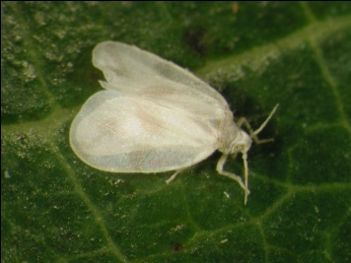
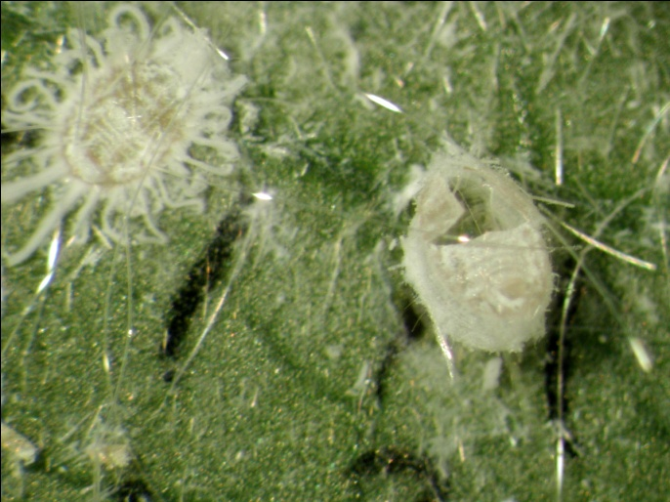
Rugose Spiraling Whitefly Aleurodicus rugioperculatus
Adult
~14 days
Puparia
~9 days
Eggs
~8 days
Nymph
~14 days
Development at 80˚F or 27˚C
Image credits:
H. Glenn, UF/IFAS, Tropical Research and Education Center
Notes:
Under laboratory conditions, the lifecycle is approximately one month long but is lengthened to approximately 60 days at 68˚F (20˚C). At approximately 77˚F (25˚C) the lifecycle is about 40 days. Once temperatures reach the 80’s (>26.5˚C), the life cycle takes about 31 days.
The time for eggs to hatch is longest under cooler temperatures taking approximately 16 days at 68˚F (20˚C), approximately 10 days at 77˚F (25˚C) and approximately 8 days when temperatures reach the 80’s (<26.5˚C). Although populations of this whitefly can decrease during the winter months, it can live year round in southern Florida.
Information sources:
Mannion, C. 2011. Unpublished research.

Slide 37
Some Rugose Spiraling Whitefly Hosts
Manila palm
Florida black olive
gumbo limbo
foraha or tamanu
cocoplum
satinleaf
coconut palm
areca palm
mango
avocado
pigmy palm
live oak
white bird of paradise
tropical almond
montgomery palm
washingtonia palm
Notes:
The hosts in bold below will be provided in the pest managers CEU, the entire list will remain in the PowerPoint for extension faculty reference.
Remember, in general, in order to be reported as a host, puparia would have to be found on the plant.
There are many hosts recorded for this pest.
Acalypha wilkesiana (Copperleaf)
Adonidia merrillii (Manila palm)
Annona sp. (Soursop)
Araucaria heterophylla (Norfolk island pine)
Brassica rapa (Field mustard or turnip)
Bucida buceras (Florida black olive)
Bursera simaruba (Gumbo limbo)
Calophyllum inophyllum (Foraha or Tamanu)
Catharanthus roseus (Madagascar periwinkle)
Chrysobalanus icaco (Cocoplum)
Chrysophyllum oliviforme (Satinleaf)
Coccothrinax sp. (Palm)
Cocos nucifera (Coconut palm)
Conocarpus erectus (Buttonwood)
Cordyline fruticosa (Hawaiian ti)
Dictyosperma album (Hurricane palm)
Dypsis decaryi (Triangle palm)
Dypsis lutescens (Areca palm)
Eugenia axillaris (White Stopper)
Eugenia uniflora (Surinam cherry)
Ficus aurea (Strangler fig)
Ficus carica (Edible fig)
Hyophorbe verschaffeltii (Spindle palm)
Mangifera indica (Mango)
Manilkara roxburghiana
Manilkara zapota (Sapodilla)
Myrica cerifera (Wax myrtle)
Myrcianthes fragrans (Simpson’s stopper)
Musa sp. (Banana)
Parthenocissus quinquefolia (Virginia creeper)
Persea americana (Avocado)
Phoenix roebelenii (Pigmy palm)
Pinanga coronata (Ivory cane palm)
Pithecellobium keyense (Florida Keys blackbead)
Psidium guajava (guava)
Quercus virginiana (Live oak)
Rosa sp.
Sabal palmetto (Sabal palm)
Sagittaria latifolia (Broadleaf arrowhead)
Schinus terebinthifolius (Brazilian pepper)
Sideroxylon foetidissimum (False Mastic)
Sideroxylon salicifolium (Willow)
Simarouba glauca (Paradise tree)
Smilax auriculata (Earleaf greenbrier)
Spondias mombin (Yellow mombin)
Spondias purpurea (Purple mombin)
Strelitzia nicolai (White bird of paradise)
Strelitzia reginae (Bird of paradise)
Syzygium cumini (Java plum)
Tabebuia spp. (Trumpet tree)
Terminalia catappa (Tropical almond)
Thespesia populnea (Portia tree)
Veitchia arecina (Montogomery palm)
Washingtonia robusta (Washingtonia palm)
Wodyetia bifurcata (Foxtail palm)
Zeuxine strateumatica (Soldier’s orchid)
Information sources:
Evans, G.A. 2008. The Whiteflies (Hemiptera: Aleyrodidae) of the World and Their Host Plants and Natural Enemies. USDA-APHIS.
accessed 2/26/2012 –
http://www.sel.barc.usda.gov:8080/1WF/World-Whitefly-Catalog.pdf
Stocks, I.C. 2012. The Rugose Spiraling Whitefly, Aleurodicus rugioperculatus Martin, a New Exotic Whitefly in South Florida (Hemiptera: Aleyrodidae). FDACS-DPI Pest Alert.
accessed 2/25/2012 –
http://www.freshfromflorida.com/pi/pest-alerts/pdf/aleurodicus-rugioperculatus-pest-alert.pdf

Slide 38
Rugose Spiraling Whitefly Damage
Image credits:
H. Glenn, UF/IFAS, Tropical Research and Education Center
Notes:
Aesthetic damage (e.g. heavy infestations with lots of honeydew, sooty mold and wax buildup) can be very evident; however, the impact of this whitefly on the plant itself is not as evident.
Depending on the type and sensitivity of the plant there may be damage such as leaf discoloration, leaf drop, and reduced plant vigor (at this time we have not seen or heard about dieback). To our knowledge, plant death has not been associated with this whitefly.
What was initially thought to be whitefly damage may instead be due to other things such as freezing. Be sure to verify the presence of an active whitefly infestation before beginning treatment.
Although typically true that whiteflies may form a relationship with ants in that the ants protect them in return for access to the honeydew they produce, we have not seen tremendous ant action which may be because of all the wax.
Information sources:
Mayer, H., J. McLaughlin, A. Hunsberger, L. Vasquez, T. Olcyzk and C. Mannion. 2010. Common questions about the gumbo limbo spiraling whitefly (Aleurodicus rugioperculatus).
accessed 2/26/2012 –
http://monroe.ifas.ufl.edu/pdf/Hort/GumboLimboSpiralingWhiteflyQuestions.pdf
Stocks, I.C. 2012. The Rugose Spiraling Whitefly, Aleurodicus rugioperculatus Martin, a New Exotic Whitefly in South Florida (Hemiptera: Aleyrodidae). FDACS-DPI Pest Alert.
accessed 2/25/2012 –
http://www.freshfromflorida.com/pi/pest-alerts/pdf/aleurodicus-rugioperculatus-pest-alert.pdf

Slide 39
Monitoring Whiteflies

Slide 40
Monitoring Whiteflies
Scouting- it is very important monitor plants (especially if a known infestation is nearby)
This allows for early detection which allows for the best management decisions
Ficus whitefly – look for live adults and nymphs
Rugose spiralling whitefly – look for the spiralling egg patterns
Bondar’s nesting whitefly – look for the waxy nests on the leaves
Notes:
When it is known that a pest is in the area, it is very important to monitor plants by scouting for the presence of these whiteflies. This allows for early detection which allows for the best management decisions.
In the case of the ficus whitefly, you only need to monitor ficus because it will not harm any other type of plant. In addition, you may be able to focus on just certain types of ficus which tend to be more susceptible (e.g. Ficus benjamina). It is important to look at the leaves for the presence of ficus whitefly, particularly the immature stages (though this can sometimes be difficult because these stages are not easy to see). Active infestations may only be detected by the presence of live adults and nymphs. In order to determine if nymphs are alive (and not remnants of a past infestation), be sure to do a fingernail test. Embed your fingernail in the center of a nymph. If it is juicy, the nymph was alive. Be sure to check several nymphs using this method. You may also see the remains of the pupal skin after the adult whiteflies have emerged though these may be from a previous infestation, not a current one.
Leaf yellowing and leaf drop are also indications of ficus whitefly, however, it takes numerous months for a population of this whitefly to build up before you see this. As these symptoms can also be caused by other issues (e.g. diseases and environmental stress), you need to be sure there are whiteflies there before treating for them. It is important to recognize that once the leaves begin to yellow, you cannot stop the leaf drop. You may also observe branch dieback during an infestation, however, this is highly variable. You can test branches that experience dieback to see if they are brittle and can break. If they do, they are dead and will not grow back. However, if the branch is flexible and doesn’t break, it is still alive and the leaves will come back given time. The stress of losing their leaves repeatedly could have some cumulative effect but it is unclear at this time what impact this may have.
Infestations of rugose spiraling and Bondar’s nesting whiteflies are a little more problematic to scout for because they have a much broader host range (which means you need to scout many plants). In the case of the rugose spiraling whitefly, an early detection sign is the presence of the eggs laid in a spiral pattern (which are quite visible even on the taller trees and palms). In the case of Bondar's nesting whitefly, an early detection sign is the presence of the pattern of wax that make the "nest" on the leaves.
If you wait to see honeydew, sooty mold, and large amounts of waxy build up, you are likely to already have a severe infestation (though this may be localized and not spread widely). Early detection of these pests makes them much easier to treat.
Information sources:
C. Mannion, unpublished data.

Slide 41
Monitoring Whiteflies
Identifying
Take an image to verify identification
If needed, submit a sample
How to collect a sample
6-12 inches of plant host material with many puparium (or pupae) placed in a sealed plastic bag
Keep it cool so that the sample does not degrade
How to submit a sample
http://edis.ifas.ufl.edu/sr010
How to find your local county faculty agent
http://solutionsforyourlife.com/map/
Notes:
It is important to make sure that you are treating the correct pest. Taking a good digital image of a questionable pest and forwarding it to you local county faculty extension agent, private laboratory or consultant is a good idea for confirmation and/or identification of the pest. Due to its small size and quick movement, taking a good digital image of a whitefly can be difficult and may not be good enough for specific identification (with the exception of the rugose spiraling whitefly due to its larger size and slower movement). When taking a picture of a questionable species, it is important to include additional pictures of the damage, any other symptoms of the infestation (e.g. wax, sooty mold, etc.), and the host plant.
Your local county faculty extension agent may submit your image to the UF Diagnostic and Identification System (http://ddis.ifas.ufl.edu/) or they may want to go out and take a look or take samples themselves. Either way, it is good to keep in contact with them.
If you want to submit a sample for identification, or a sample is requested from you based on the images you have submitted, there are a few steps that need to be followed.
In order to identify a whitefly to species, you need to collect the puparia (or pupae). Because the puparia or pupae remain attached to the leaves, be sure to collect 6-12 inches of plant material (with many leaves and puparium on them) and put it in a plastic bag (though it would not hurt to double bag the sample). You need that much of the plant because host information is very helpful in identification and determining new host records for a particular species. Do not leave the sample in the heat (putting it in a cooler is good) and be sure to deliver your sample fairly quickly as the sample will deteriorate in a short amount of time. If you need to locate your county faculty extension agent, here is the website http://solutionsforyourlife.com/map/.
County extension offices then send samples to the Insect Identification Laboratory in Gainesville, Florida (http://edis.ifas.ufl.edu/sr010) or other UF/IFAS diagnostic labs (e.g. Apopka and Homestead). If the species is not familiar, the Insect Identification Laboratory then corresponds with the Florida Department of Agriculture and Consumer Services - Division of Plant Industry (FDACS-DPI) taxonomic specialists in Gainesville, Florida. New (to Florida) species are always confirmed and/or identified by FDACS-DPI and/or USDA. The species that we are discussing in this presentation are already known to be established in Florida, therefore, species confirmations by FDACS-DPI would only likely occur for new county records, new hosts or if sufficient changes in the pest activity suggested that a specimen should be double-checked taxonomically to further investigate its identity. Any plant listed on the host list for a specific insect must also be confirmed by FDACS-DPI. If you suspect you have a new invasive species other than the ones that have been presented here (as they are known to be established), you may contact the DPI helpline at 888-397-1517.
If a new (not known to occur whitefly species) is reported in Florida, it might be possible to prevent its establishment if the species is detected early.
Information sources:
Hodges. G.S. and G.A. Evans. 2005. “An Identification Guide to the Whiteflies (Hemiptera: Aleyrodidae) of the Southeastern United States”. Florida Entomologist, Volume 88, issue 4, pp. 518-534.
Hodges, G.S., Florida Department of Agriculture and Consumer Services, Division of Plant Industry. Personal Communication. greg.hodges@freshfromflorida.com
Stocks, I.C., Florida Department of Agriculture and Consumer Services, Division of Plant Industry. Personal Communication. ian.stocks@freshfromflorida.com

Slide 42
Managing Whiteflies

Slide 43
Managing Whiteflies: Cultural Control
Use alternative or non-host plants when possible
If moving infested plant material, bag it or cover it!
Check your equipment and yourself for infested material that “sticks” and for insects that are “hitchhiking”
Washing plants with water
Notes:
In general, it is not recommended to start removing trees and shrubs. However, to some extent part of the problem with the ficus whitefly issue is the overplanting of ficus in the landscape in the first place. Because this whitefly only gets on ficus (though not all species of ficus), you can choose to use alternate or non-host plants when planting new trees or shrubs or replacing dead ficus plants. Recommendations for replacement plants will vary depending on where you are in the state and what you want (e.g. privacy hedge, shade, wind breaks, etc.). Many of the extension offices have lists of recommended plants to choose from so it is probably best to discuss options with your local extension office (http://solutionsforyourlife.com/map/).
In the case of the other whiteflies that have a wider host range, alternative plants may not be the answer. For example, the rugose spiraling whitefly will lay its eggs on both plant and non-plant surfaces. Though the eggs may not develop on all plants on which they are laid, they do seem to survive well on most.
It is possible to spread ficus whitefly through movement of infested leaves because this species can survive on dying or dropped leaves (rugose spiraling whitefly, however, does not appear to survive well on excised leaves). For example, if you use blowers to move leaves around in a given area, be careful that you are not spreading infested leaves to non-infested hosts. In addition, be sure to check your county restrictions to determine if you are able to bag yard trash (including infested material) for disposal. If you are going to dispose of the yard trash, be sure to bag or cover the materialduring transport so that you are not infesting new areas as you drive along.
Furthermore, whiteflies that produce excessive honeydew can easily stick to you or your equipment so it is important to inspect yourself and your equipment before leaving a property that has infested plants.
It helps in monitoring and scouting efforts to wash the wax and sooty mold off infested plants. This also makes it easier to determine if strategies such as chemical controls are working effectively. The washing efforts can also be very useful as it can remove the immobile stages of this pest (e.g. the stages that cannot get back on the plant).
Information sources:
C. Mannion, unpublished data.

Slide 44
Managing Whiteflies: Biological Control
What are natural enemies or biocontrol agents?
Important for long term management of pests
Predators versus parasites
Buying and releasing natural enemies
Notes:
There are numerous biological agents that can attack and kill these whitefly pests. These are called natural enemies or biocontrol agents. Some are predators, some are parasites or parasitoids, some are native to Florida, while others may have come in with introduced pests or even been released for control of other pests in the past. Examples of these include beetles, flies, wasps, lacewings, mites, nematodes, and fungal and bacterial diseases. Protection and conservation of these organisms is extremely important in the long term management of any pest. Although pesticides may be needed to provide intitial control, using the correct products, formulations, methods of applications and timing will help conserve the natural enemies for long term control.
Predatory insects and mites will feed on and consume numerous garden and landscape pests (very rarely do they eat only one pest species). However, their work can be hampered by things like insect excretions, plant structures, or plant produced substances. They tend to work best at finding their prey when the prey population is high.
Parasitoids or parasites (such as tiny wasps) will feed on or in an individual host. These, unlike many of the predators, tend to be fairly specific in their prey or host preference (including targeting a particular developmental stage of the host). Parasitoids and parasites tend to be quite small and often difficult to see, but can work well even when host populations are low.
You can purchase natural enemies to release, but it is imperative that the right natural enemy is matched to the right pest. Even with generalist predators, there are some that work better on certain pests. The parasitic wasps tend to be much more specific so even if you can buy one that does attack whiteflies, it may not attack the specific whiteflies discussed here. Studies are ongoing to determine if there are commercially available natural enemies for these particular whiteflies. Another important issue about buying and releasing natural enemies in the landscape is the number to release. It often takes thousands of individuals and numerous releases in order for them to become established in an area. In essence, releasing natural enemies requires critical information on the species of pest and natural enemy.
Information sources:
IPM Florida, Solutions for your Life. Natural Enemies.
accessed 3/23/2012 –
http://ipm.ifas.ufl.edu/resources/grants_showcase/people_and_communities/natenemy.shtml
Leppla, N.C. and K.L. Johnson. 2011. Guidelines for purchasing and using commercial natural enemies and biopesticide in Florida and other states. EDIS.
Accessed 3/23/2012 –
http://edis.ifas.ufl.edu/in849

Slide 45
Parasitoids Associated with Ficus Whitefly
Amitus bennetti
Encarsia protransvena
Image credits:
H. Glenn, UF/IFAS, Tropical Research and Education Center
Notes:
These two wasp parasites have been observed attacking ficus whitefly.
Amitus bennetti is a solitary parasitoid wasp (in the family Platygasteridae) that preys on many species of whitefly. It has a black body with dark legs and measures just over 1/64in or 0.5mm in length. It is not native to Florida but was introduced many years ago and has become established in the environment.
Encarsia species are minute, parasitic wasps that attack various stages of whiteflies, armored sales, aphids, and lepidopteran eggs. Encarsia protransvena (in the family Aphelinidae) preys on many whiteflies include Bemisia species. The body of the female is yellow and measures less than 1/32in or 0.7mm in length. The antennae is also yellow and the legs are pale. The body of the male is predominantly brown with lighter colored legs. This species was originally discribed from Florida, however, it is not known if it is a native species or one that was introduced previously, but went undetected.
Encarsia protransvena is much more common than Amitus bennetti and has been used for whitefly management of other types of whiteflies in the past. However, currently, it is not commercially available.
Information sources:
CSIRO. 2001. Encarsia protransvena Viggiani. Encarsia of Australia Online.
accessed 2/26/2012 –
http://www.ces.csiro.au/science/encarsia/pro_ss.htm
Drost, Y. C., Y. T. Qiu, C. J. A. M. Posthuma-Doodeman and J. C. van Lenteren. 1999. “Life-history and oviposition behaviour of Amitus bennetti, a parasitoid of Bemisia argentifolii”. Entomologia Experimentalis et Applicata, volume 90, pp. 183-189.
Evans, G.A. USDA-APHIS-NIS, personal communication. Gregory.A.Evans@aphis.usda.gov
Viggiani, G. 1985. “ Notes on a few Aphelinidae, with description of five new species of Encarsia Foerster (Hymenoptera, Chalcidoidea)”. Bollettino del Laboratorio di Entomologia Agraria Filippo Silvestri, Volume 42, pp. 81-94.
accessed 2/26/2012 –
http://www.nhm.ac.uk/resources/research-curation/projects/chalcidoids/pdf_X/Viggia985d.pdf
Viggiani, G. and G.A. Evans. 1992. “Descriptions of three new species of Amitus Haldeman (Hymenoptera: Platygasteridae), parasitoids of known whiteflies from the New World”. Bollettino del Laboratorio di Entomologia Agraria Filippo Silvestri, vol. 49, pp. 189-194.

Slide 46
Parasitoids Associated with Rugose Spiraling Whitefly
Encarsia guadalupae
Aleuroctonus sp.
Image credits:
H. Glenn, UF/IFAS, Tropical Research and Education Center
Notes:
Encarsia guadalupae is a parasitoid that has been found attacking the rugose sprialing whitefly. Although another parasitoid was initially found attacking this whitefly (Aleuroctonus sp.), E. guadalupae appears to be the dominant one. The adults are small and often difficult to see, but the best evidence of parasitism are the exit holes in the immature whitefly.
Encarsia guadalupae is not native to Florida and probably arrived by an accidental introduction. It is in the Aphelinidae family and is very small. It’s head and body are predominately brown with yellow legs.
Aleurotonus sp. is in the Eulophidae family and is slightly larger than E. guadalupae with a dark head and thorax with white legs. The tip of the thorax is also dark. Confirmation that this parasitoid attacks the rugose spiraling whitefly is still under investigation.
Information sources:
G. Evans, USDA ARS Systematics Entomology Lab, personal communication.
National Bureau of Agriculturally Important Insects (NBAII). Encarsia guadeloupae Viggiani.
Accessed 3/23/2012 –
http://www.nbaii.res.in/Featured%20insects/encarsia_guadeloupae.htm

Slide 47
How to Tell if the Nymphs have been Parasitized
Sometimes you can see the parasite in the whitefly nymph
Parasitized nymphs often appear dark in color
↑
Adult parasites that have emerged leave a circular hole
↓
Adult whiteflies that have emerged leave a “ripped” hole – NOT PARASITIZED
Image credits:
H. Glenn, UF/IFAS, Tropical Research and Education Center
Notes:
It is usually difficult to see parasitoids/parasites due to their very small size. However, these natural enemies often attack the immature stages of the whitefly which sometimes causes them to turn dark in color (see images above). Upon closer examination, you can sometimes see the parasite inside the whitefly.
Inspecting the nymphs with a hand lens will also help identify whitefly nymphs that have already been parasitized. Whitefly immature stages with even, circular holes are indicative that they were parasitized and now the adult wasp has emerged. However, do not get this confused with the hole left by the adult whitfly emerging from the puparium (or pupa). These holes will look more “ripped” open.
Information sources.
DeBach, P. and D. Rosen. 1991. Biological Control by Natural Enemies. Cambridge University Press.

Slide 48
Predators Associated with Ficus Whitefly
Harmonia axyridis
Olla v-nigrum
Exochomus childreni
Chilocorus nigritis
Curinus coeruleus
Image credits:
Harmonia axyridis - Gyorgy Csoka, Hungary Forest Research Institute, www.bugwood.org, #5410810
Olla v-nigrum - Louis Tedders, USDA Agricultural Research Service, www.bugwood.org, #1223031
Exochomus childreni and Chilocorus nigritis - H. Glenn, UF/IFAS, Tropical Research and Education Center
Curinus coeruleus - Forest & Kim Starr, Starr Environmental, www.bugwood.org, #5219057
Notes:
These predators have all been observed in association with ficus whitefly. Remember not all predators will feed on all whiteflies. Predatory beetles feed on their hosts both as adults and larvae.
Harmonia axyridis is the multicolored Asian lady beetle. They are not native (they are from Asia), but they occur in many area of the United States due to multiple introductions as a biocontrol agent for many different pest species. It measures about 1/4in or 5 to 8mm in length and about 1/4in or 4 to 7mm in width. The body shape is oval. They have a high degree of variation in their color patterns which range from pale yellow-orange to almost black, with no spots or many black spots. These are the ladybird beetles that try to overwinter in your house. The larvae are black to dark bluish gray in color with a bright yellow-orange patch located on the front half of the abdomen. They have blunted tubercles and spines on their body.
Olla v-nigrum is a native predator found from southeastern Canada down to Florida, across to California and up to southern British Columbia. It measures 1/8 to 1/4in or 3.7 to 6.1mm in length and about 1/8 to 1/4in or 3 to 5mm in width. The color pattern varies with the background color ranging from black to pale yellow. Spot patterns can vary as well from many dark, irregular spots on the light background to very few spots (2 or so) on the dark background.
Exochomus childreni is native to the southern United States and has 2 subspecies: childreni (known from Florida) and guexi (known from Texas and Louisiana). It measures about 1/8in or 2.8 to 3.6mm in length and about 1/8in or 2.3 to 3mm in width. It has a black head and pronotum (area just before the wing coverings or elytra), but the wing coverings are yellowish red with a few large black spots.
Chilocorus nigritis is a shiny black coccinellid, a little more than 1/8in or 4mm in size and more or less circular in shape. The head is orange and mostly hidden under the elyra. The larvae are yellow-brown. This predator is considered a predator of armored scales. It is possible they are not actually feeding on the whitefly but looking for scale. Testing is needed to determine if they will feed on whitefly.
Curinus coeruleus was introduced for biological control in 1953, however, it was unsuccessful. Sometime over the next several years after that failed attempt, however, it was detected in southern Florida. It is native to Mexico. It has also be released in several other places for control of different pests including in Hawaii. It is a small (a little less than 1/4in or 5 mm in length) oval, dark bluish beetle with two red-orange spots on the head. The ventral side is orange-yellow. Larvae are dark gray with yellow heads and numerous spines.
Information sources:
Global Invasive Species Database. Harmonia axyridis.
accessed 2/26/2012-
http://www.issg.org/database/species/ecology.asp?fr=1&si=668
Gordon, R.D. 1985. “The Coccinellidae (Coleoptera) of America North of Mexico”. Journal of the New York Entomological Society, vol. 93, no. 1, pp. 1-912.
National Bureau of Agriculturally Important Insects (NBAII). Chilocorus nigrita (Fabricius).
Accessed 3/23/2012 –
http://www.nbaii.res.in/Featured%20insects/Chilocorus.htm
National Bureau of Agriculturally Important Insects (NBAII). Curinus coeruleus (Mulsant).
Accessed 3/23/2012 –
http://www.nbaii.res.in/Featured%20insects/Curinus_coeruleus.htm

Slide 49
Predators Associated with Rugose Spiraling Whitefly
Nepasphis oculata
Adult
Larva
Image credits:
Lance Osborne, UF/IFAS, Mid-Florida Research and Education Center
Notes:
Nephaspis oculatus is a small brown coccinellid beetle with a light colored head and thorax (the female is uniformly brown). It is a predator which feeds on many whitefly species. It measures about 1/16in or 1.5 mm in length and about 1/32in or 1.0 mm in width. It has been successfully introduced from Central America to different areas for spiraling whitefly control. Its life cycle is approximately 51 days.
The larvae are white and measure about 1/8in or 2.55mm in length and 1/64in or 0.33mm in width just before they pupate.
Information sources:
Gordon, Robert D. 1985. The coccinellidae (Coleoptera) of America north of Mexico. Journal of the New York Entomological Society 93:1-912.
Liu, Tong-Xian, Philip A. Stansly, Kim A. Hoelmer, and Lance Osborne. 1997. Life history of Nephaspis oculatus (Coleoptera: Coccinellidae) a predator of Bemisia argentifolii (Homoptera: Aleyrodidae). Ann. Entomol. Soc. Am. 90(6):776-781.
Liu, T.-X., and P. A. Stansly. 1996. Morphology of Nephaspis oculatus and Delphastus pusillus (Coleoptera: Coccinellidae), predators of Bemisia argentifolii (Homoptera: Aleyrodidae). Proc. Entomol. Soc. Wash. 98: pp.292-300.

Slide 50
Predators Associated with both Rugose Spiraling Whitefly and Ficus Whitefly
Adult
Eggs
Larva
Image credits:
Lacewing adult – David Cappaert, Michigan State University, www.bugwood.org, #5351009
Lacewing larvae – USDA ARS Photo Unit, USDA Agricultural Research Service, www.bugwood.org, #1323013
Lacewing eggs - Gerald J. Lenhard, Louiana State Univ, www.bugwood.org, #0014149
Notes:
Lacewings are generalist predators that are known feeding on aphids, mealybugs and other soft bodied insects but have been seen associated with all the whiteflies. The lacewings may be feeding on these whiteflies but may also be feeding on other pests on the plants. It is not uncommon to see their eggs on leaves and sometimes their larvae in association with whiteflies. The larvae are highly predaceous.
Information sources:
Henn, T., R. Weinzierl and P. G. Koehler. 2009. Beneficial insects and mites. EDIS.
Accessed 3/23/2012 –
http://edis.ifas.ufl.edu/in078
IPM Florida, Solutions for your Life. Effect of Adult Lacewing Releases in Tomato Field Perimeters on Silverleaf Whitefly Populations and TYLCV Incidence.
Accessed 3/23/2012 - http://ipm.ifas.ufl.edu/resources/grants_showcase/vegetables/lacewing_tomato.shtml
MacLeod, E.G. and L.A. Stange. 2011. Brown lacewings of Florida (Insecta: Neuroptera: Hemerobiidae). EDIS.
Accessed 3/23/2012 –
http://edis.ifas.ufl.edu/in382
Mannion, C. unpublished data.

Slide 51
Managing Whiteflies: Chemical Control
Soaps and oils
Horticultural oil or insecticidal soap
Essentially suffocates the pest
Strictly contact so thorough coverage is required
Repeated applications are required every 7-10 days
Phytotoxicity can occur under high temperatures leading to plant damage
Notes:
The use of soaps and oils are useful particularly for shorter plants and light infestations (sometimes these are also good when used in combination with insecticides). Soaps and oils degrade rapidly and have low mammalian toxicity, but they can have an immediate impact on pest behavior. There is a chance of phytotoxicity depending on plant species or even temperature, so it is recommended to test a small area of the plant first before applying the treatment to the whole plant.
Information sources:
Buss, E.A. and S.G. Park-Brown. 2009. Natural Prodcuts for Insect Pest Management. EDIS.
accessed 3/23/2012 –
http://edis.ifas.ufl.edu/in197
Scherer, C. W., P. G. Koehler, D. E. Short and E. A. Buss. 2006. Landscape integrated pest management. EDIS.
Accessed 3/22.2012 –
http://edis.ifas.ufl.edu/in109

Slide 52
Managing Whiteflies: Chemical Control
Insecticides
Sometimes important in the early management of a pest
Appropriate choices of insecticide, formulation, methods of application and frequency of application
Effects on natural enemies
Misuse or overuse can cause problems such as insecticide resistance, secondary pest problems, environmental contamination, and detrimental effects on non-target organisms
Follow label instructions - The site and method of application must be on the label (e.g.. landscape, nursery, etc.)
Notes:
Be sure the label has the site (i.e. landscape) and the method of application you plan to use.
There are potential fines from the Florida Department of Agriculture and Consumer Services, Division of Agriculture and Environmental Services (FDACS-AES) for use of off label products. In addition, given the concerns that have been raised about potential environmental contamination from soil applied products, it is important to recognize that you need to use insecticides labeled for the use site only. If you plan to apply a particular chemical in the landscape, then it must state that you can apply it in the landscape in the label.
The method of application (e.g. drench, foliar, bark sprays, etc.) must also be on the label. Do not use a product in any other way than what is listed on the label. This is important in order to get the maximum benefit from the product with the least amount of detrimental impact. Of course, this is also what is legal.
Some host plants mentioned here are considered “food” and thus very few pesticides are labeled for use on them. Coconut palms that produce nuts are an example. In addition, some labels state “This product is not to be used on trees that will produce food within the year following treatment.”, so be sure to read the label carefully before applying pesticides.

Slide 53
Managing Whiteflies: Chemical Control
Foliar application of chemicals
Whitefly should be present
Foliar insecticides may provide quick control, most will not provide long-term control.
Some foliar insecticides (e.g. pyrethroids) may disrupt the natural enemies and should be used selectively.
It is not recommended to use the same insecticide on both the foliage and in the soil
Notes:
Because many of the insecticides used as a foliar spray do not last very long, you want to be sure there are live whiteflies before application. Foliar sprays are NOT to be used for preventative control.

Slide 54
Insecticide Selection for Foliar Application Professional Use (Landscape and Nursery)
Abamectin (Avid)
Acetamiprid (TriStar)
Azadirachtin (Azatin XL)
Bifenthrin (Talstar)
Buprofezin (Talus)
Clothianidin (Arena)
Flonicamid (Aria)
Horticultural oils
Imidacloprid (Merit, Marathon, Discus, Allectus)
Kontos (Spirotetramat)
Pymetrozine (Endeavor)
Pyriproxyfen (Distance)
Spiromesifen (Judo)
Beauveria bassiana (BotaniGard)
Isaria fumosorosea (PreFeRal)
Notes:
The two products highlighted in yellow are fungi (entomopathogens).

Slide 55
Managing Whiteflies: Chemical Control
Systemic applications of chemicals
Apply a systemic insecticide to the soil or trunk
Trunk application (basal spray, injection)
Soil application (drench, granular, pellets)
Provides longer term control
Notes:
You can apply insecticides systemically using one of two methods: trunk application or soil application. Systemic applications of insecticides provide longer term control (typically 6 to 12 months depending on the active ingredient, the rate, the method of application, the type of plant and environmental conditons).
It is important to check the labels because not all active ingredients can be applied with all methods.

Slide 56
Managing Whiteflies: Chemical Control
Methods of Application for Neonicotinoids
There are several ways to apply neonicotinoid insecticides
Take advantage of the different methods and formulations
Fit the method of application to the site
Both the site and method need to be on the label
Notes:
The neonicotinoids are a very effective group of insecticides and because there are several active ingredients and methods of application, you can fit the most appropriate product and methods to fit your needs. On larger sites, it is often suggested to use a tiered system in which different methods are used at a site depending on need. For example, some highly infested trees or infested trees in high traffic areas may need immediate control versus those trees that have a lighter infestation or are removed from the public where there is less demand for control.
Neonicotinoid insecticides are a primary tool being used for whitefly management. For the longest term control, it is recommended to apply these products to the soil or trunk which allows you to take advantage of the full systemic properties of these products. However, there are several factors that influence the efficacy of neonicotinoids applied to the soil or trunk.
Size of tree – larger trees need proportionately more product because foliage biomass increases exponentially with trunk diameter. It also takes longer for large trees to move the product.
Application rate – using less than labeled rates can result in poor control.
Soil moisture – dry soils can bind up less soluble products.
Transpiration rate – this is what drives the uptake of water (and the neonicotinoids) from the soil into the tree and affects the movement of the water and product that is carried throughout the tree tissues. Lower transpiration rates mean slower uptake and slower control. Higher transpiration rates (providing the tree has access to plenty of water) means faster uptake and faster control.
There are several primary factors that influence transpiration rate.
1. Leaf age – older leaves transpire less than new leaves and therefore take up water more slowly. Older leaves can also serve as reservoirs for whiteflies.
2. Growth rate of plant – Slower growth rate means slower water uptake.
3. Heavily infested or otherwise unhealthy plants – infested and unhealthy plants do not take up water from soil as effectively as healthy plants.
4. Soil moisture – dry soil reduces rate of water uptake.
5. Irrigation and rainfall – influences soil moisture.
6. Temperature – temperatures that are above or below the optimal temperature for plant growth will slow water uptake.
7. Chemical properties of product - neonicotinoids vary in water solubility, binding potential to soil, and half life. These factors will influence how much product is dissolved in the water and taken up by tree (and therefore the speed with which the chemical reaches effective concentration). This can also influence how long neonicotinoids remain at effective concentrations in the leaf tissue.

Slide 57
Systemic insecticides – soil and trunk methods
Drench
Granular
Injection
Trunk spray
Image credits:
Top – H. Glenn, UF/IFAS Tropical Research and Education Center
Bottom left – C. Mannion, UF/IFAS Tropical Research and Education Center
Bottom right - J. Chamberlin, Valent, Inc.
Notes:
One of the soil application methods is drenching in which the insecticide is mixed with water and poured or sprayed around the base of the tree. It is important to use sufficient water to move the product to the roots of the plants. If the ground is unusually dry or there is a thick layer of mulch, more water will be required or the mulch will need to be removed. Also, under dry conditions, the insecticide can bind to the soil and become less available to the tree. Drenching when the soil is moist will provide the best uptake. Be sure to follow the instructions on the label carefully for this method.
Some of these products come in a granular formulation and can be spread around the base of the tree. Often these products take a little longer to work. Read the label on using these products because it is often suggested to follow with irrigation or to use before expected rain to insure that the insecticide gets to the roots.
There are two trunk applications: basal trunk spray and injection. Tree injection takes specialized equipment and the products need to be formulated for injection (not all are). It generally allows for quicker action of the product moving to the leaves and may be an ideal method for situations where it is difficult to use water. Methods and instructions for injection are included on the label. If you are using a particular system, you can also go to their website for additional information on how to inject the product.
Some products have included a basal trunk spray as a method of application. This method may be ideal for larger trees or in areas where it might be difficult to drench or use a granular. Be sure to follow the instructions on the label for this method.

Slide 58
Neonicotinoid Insecticides
Active Ingredient | Trade Names Professional Use
Acetamiprid | TriStar* # (no soil application)
Clothianadin | Arena, Aloft*
Dinotefuran | Safari#, Zylam#
Imidacloprid | Merit, Marathon, CoreTect, Discus*, Allectus*, several generic labels
Thiamethoxam | Flagship, Meridian
* Contains a neonicotinoid and a pyrethroid
# Allows basal trunk spray
Notes:
List of neonicotinoid insecticides with some trade names

Slide 59
Conditions that Affect Management of These Pests
Rugose spiraling whitefly and Bondar’s nesting whitefly
Less rain makes the infestations appear worse
Large host range makes them diffucult to manage
Excessive wax can affect contact beetwen the insect and the insecticide
Ficus whitefly
Be patient while the leaves comes back and check the health of your ficus often
Try not to prune during recovery
Notes:
With rugose spiraling whitefly or Bondar’s nesting whitefly, during a drought, there is less of a “washing” effect of rain, so infestations can appear worse than they actually are. In addition, a large host range makes management of both these pests difficult.
The excessive wax that they produce can even impede contact between insecticide and insect. This wax typically dissipates quickly as the populations go down, but the sooty mold remains much longer.
With ficus whitefly, even after treatment, it will take a while for the leaves to come back and if you have waited until the leaves are yellow, they will drop no matter what you do. It is best to prune prior to insecticide application and, if possible, during the time of recovery try to prune less.

Slide 60
Addressing Damage to Plants Caused by Whiteflies
Proper fertilization and watering can help plants recover
However, over fertilizing will actually help the pests and lead to run-off issues
Beware: Nothing changes overnight and it sometimes takes time for plant recovery
Notes:
Proper fertilization and watering will help plants to recover. Be aware that nothing changes overnight and it sometimes takes time for the plants to recover. The best fix is to reduce or control the pest population and then apply the best horticultural practices for the host plant. If possible, avoid or stop other stresses on the host plants by providing sufficient water and fertilizer as well as trying to keep pruning or other cultural practices to a minimum until the plant recovers.

Slide 61
Removing Honeydew and Sooty Mold
Control pest problem
Move property from infested area if possible
Particularly for cars
Pressure washing
Soaps and oils
Be careful of plant damage
Mold remover products
Be especially careful about use on plants
Remove honeydew as soon possible
Notes:
Controlling the numbers of pests that produce honeydew is the best preventative measure.
As honeydew can fall on any surface under an infested plant including cars, children's toys, pool decks and sidewalks, not leaving property under infested trees (when possible) is highly recommended.
Some professionals recommend using pressure washers to remove honeydew from hard surfaces like sidewalks and pool decks.
Soaps and oils can potentially remove and reduce the build up of sooty mold.
The efficacy of mold remover products are not known at this time.
Remember, honeydew is a sticky mess that will require some elbow grease to remove. Its removal will be easier if it is washed off as soon as possible. Once bacteria and fungi have an opportunity to begin to grow, it will be more difficult to remove.

Slide 62
Content Contributors
Catharine Mannion, PhD, UF/IFAS Tropical Research and Education Center
Lance Osborne, PhD, UF/IFAS Mid Florida Research and Education Center
Eileen Buss , PhD, Department of Entomology and Nematology, University of Florida
John L. Capinera, PhD, Department of Entomology and Nematology, University of Florida
Jennifer Gillett-Kaufman, PhD., Department of Entomology and Nematology, University of Florida
Amanda Hodges, PhD, Department of Entomology and Nematology, University of Florida
Greg Hodges, PhD, Florida Department of Agriculture and Consumer Services, Division of Plant Industry
Bill Schall, Commercial Horticultural Extension Agent, Palm Beach County Faculty
Ian Stocks, PhD, Florida Department of Agriculture and Consumer Services, Division of Plant Industry
Stephanie Stocks, MS, Department of Entomology and Nematology, University of Florida
Published: May 2012

Slide 63
Educational Disclaimer and Citation
This presentation can be used for educational purposes for NON-PROFIT workshops, trainings, etc.
Citation:
Mannion, C., L. Osborne, E. Buss, J.L. Capinera, J. Gillett-Kaufman, A. Hodges, G. Hodges, B. Schall, I. Stocks, and S. Stocks. 2012. Invasive Whitefly Pests of Florida. Updated April 2012. accessed (add the date), www.flwhitefly.org.

Slide 64
Partnering Agencies
Florida Department of Agriculture and Consumer Services, Division of Plant Industry
University of Florida, Department of Entomology and Nematology
Pest Management University
IPM Florida
IFAS Extension – Broward County
IFAS Extension – Lee County
IFAS Extension – Miami-Dade County
IFAS Extension – Palm Beach County
Southern Plant Diagnostic Network

Slide 65
References
Bohmfalk, G.T., R.E. Frisbie, W. L. Sterling, R.B. Metzer, and A.E. Knutson. 2011. Identification, biology, and sampling of cotton insects. Texas AgriLife Extension. accessed 3/19/2012 –
http://www.soilcropandmore.info/crops/CottonInformation/insect/B-933/b-933.htm
Borrer, D.J. and R.E. White. 1970. Peterson Field Guide to Insects. Houghton Mifflin Co., New York.
Borrer, D.J., C.A. Triplehorn, N.F. Johnson. 1989. An Introduction to Insects. Sixth Edition. Saunders College Publishing. New York.
Buss, E.A. and S.G. Park-Brown. 2009. Natural products for insect pest management. EDIS. accessed 3/23/2012 –
http://edis.ifas.ufl.edu/in197
CABI. 2012. Bemisia tabaci. Invasive Species Compendium (beta). accessed 2/27/2012 –
http://www.cabi.org/isc/?compid=5&dsid=8927&loadmodule=datasheet&page=481&site=144
Notes:
The references used in this scripted presentation are included for the educators. It is your choice to leave them in or take them out when delivering the material to the audience.

Slide 66
References
CABI. 2012. Dialeurodes citri (citrus whitefly). Invasive Species Compendium (beta). accessed 2/28/2012 –
http://www.cabi.org/isc/?compid=5&dsid=18698&loadmodule=datasheet&page=481&site=144
CABI. 2012. Paraleyrodes bondari. Invasive Species Compendium (beta). accessed 2/25/2012 –
http://www.cabi.org/isc/?compid=5&dsid=116127&loadmodule=datasheet&page=481&site=144
CSIRO. 2001. Encarsia protransvena Viggiani. Encarsia of Australia Online. accessed 2/26/2012 –
http://www.ces.csiro.au/science/encarsia/pro_ss.htm
DeBach, P. and D. Rosen. 1991. Biological Control by Natural Enemies. Cambridge University Press.

Slide 67
References
Drost, Y. C., Y. T. Qiu, C. J. A. M. Posthuma-Doodeman and J. C. van Lenteren. 1999. “Life-history and oviposition behaviour of Amitus bennetti, a parasitoid of Bemisia argentifolii”. Entomologia Experimentalis et Applicata, volume 90, pp. 183-189.
Evans, G.A. 2008. The Whiteflies (Hemiptera: Aleyrodidae) of the World and Their Host Plants and Natural Enemies. USDA-APHIS.
Fasulo, T.R. and H.V. Weems. 2010. Citrus whitefly. UF Featured Creatures. accessed 2/28/2012 –
http://entnemdept.ufl.edu/creatures/citrus/citrus_whitefly.htm

Slide 68
References
Global Invasive Species Database. Harmonia axyridis. accessed 2/26/2012-
http://www.issg.org/database/species/ecology.asp?fr=1&si=668
Gordon, R.D. 1985. “The Coccinellidae (Coleoptera) of America North of Mexico”. Journal of the New York Entomological Society, vol. 93, no. 1, pp. 1-912.
Henn, T., R. Weinzierl and P. G. Koehler. 2009. Beneficial insects and mites. EDIS. Accessed 3/23/2012 –
http://edis.ifas.ufl.edu/in078
Hodges, G. 1996. Bemisia tabaci (Gennadius) (biotype ‘Q’): A potential new biotype for Florida’s vegetable and ornamental crops. (Hemiptera: Aleyrodidae). FDCAS-DPI pest Alert. accessed 2/27/2012 –
http://www.freshfromflorida.com/pi/pest-alerts/bemisia-tabaci.html

Slide 69
References
Hodges, G.S. 1997. Giant whitefly, Aleurodicus dugesii Cockerell, in Florida. FDACS-DPI Pest Alert. accessed 2/25/2012 –
http://www.freshfromflorida.com/pi/pest-alerts/aleurodicus-dugesii.html
Hodges. G.S. and G.A. Evans. 2005. “An identification guide to the whiteflies (Hemiptera: Aleyrodidae) of the southeastern United States”. Florida Entomologist, Volume 88, issue 4, pp. 518-534.
Hodges, G.S. 2007. The fig whitefly Singhiella simplex (Singh) (Hemiptera: Aleyrodidae): a new exotic whitefly found on ficus species in South Florida. FDACS-DPI Pest Alert. accessed 2/25/2012-
http://www.freshfromflorida.com/pi/pest-alerts/singhiella-simplex.html
IPM Florida, Solutions for your Life. Natural enemies. accessed 3/23/2012–
http://ipm.ifas.ufl.edu/resources/grants_showcase/people_and_communities/natenemy.shtml

Slide 70
References
Legaspi, J.C., C. Mannion, D. Amalin, and B.C. Legaspi, Jr. 2011. “Life table analysis and development of Singhiella simplex (Hemiptera: Aleyrodidae) under different constant temperatures”. Annals of the Entomological Society of America, vol. 104, issue 3, pp. 451-458.
Leppla, N.C. and K.L. Johnson. 2011. Guidelines for purchasing and using commercial natural enemies and biopesticide in Florida and other states. EDIS. accessed 3/23/2012 –
http://edis.ifas.ufl.edu/in849
Liu, T.-X., and P. A. Stansly. 1996. “Morphology of Nephaspis oculatus and Delphastus pusillus (Coleoptera: Coccinellidae), predators of Bemisia argentifolii (Homoptera: Aleyrodidae)”. Proc. Entomol. Soc. Wash. 98: pp.292-300.

Slide 71
References
Liu, Tong-Xian, Philip A. Stansly, Kim A. Hoelmer, and Lance Osborne. 1997. “Life history of Nephaspis oculatus (Coleoptera: Coccinellidae) a predator of Bemisia argentifolii (Homoptera: Aleyrodidae)”. Ann. Entomol. Soc. Am. 90(6):776-781.
MacLeod, E.G. and L.A. Stange. 2011. Brown lacewings of Florida (Insecta: Neuroptera: Hemerobiidae). EDIS. Accessed 3/23/2012 –
http://edis.ifas.ufl.edu/in382
Mannion, C. 2010. Ficus whitefly – management in the landscape. Accessed 3/8/2012 –
http://trec.ifas.ufl.edu/mannion/pdfs/Ficus%20Whitefly%20(Feb2010)%20Fact%20Sheet.pdf
Martin, J. H. 1996. “Neotropical whiteflies of the subfamily Aleurodicinae established in the western Palearctic (Homoptera: Aleyrodidae)”. Journal of Natural History 30: 1849–1859.

Slide 72
References
Mayer, H., J. McLaughlin, A. Hunsberger, L. Vasquez, T. Olcyzk and C. Mannion. 2010. Common questions about the gumbo limbo spiraling whitefly (Aleurodicus rugioperculatus). accessed 2/26/2012 –
http://monroe.ifas.ufl.edu/pdf/Hort/GumboLimboSpiralingWhiteflyQuestions.pdf
McAuslane, H. 2009. Sweetpotato whitefly Bemisia tabaci. UF Featured Creatures. accessed 2/28/2012 –
http://entnemdept.ufl.edu/creatures/veg/leaf/silverleaf_whitefly.htm
National Bureau of Agriculturally Important Insects (NBAII). Encarsia guadeloupae Viggiani. accessed 3/23/2012 –
http://www.nbaii.res.in/Featured%20insects/encarsia_guadeloupae.htm
National Bureau of Agriculturally Important Insects (NBAII). Chilocorus nigrita (Fabricius). Accessed 3/23/2012 –
http://www.nbaii.res.in/Featured%20insects/Chilocorus.htm

Slide 73
References
National Bureau of Agriculturally Important Insects (NBAII). Curinus coeruleus (Mulsant). Accessed 3/23/2012 –
http://www.nbaii.res.in/Featured%20insects/Curinus_coeruleus.htm
Natwick, E.T. and F. F. Laemmlen. 1993. “Protection from phytophagous insects and virus vectors in honeydew melons using row covers”. Florida Entomologist, vol. 76, no. 1, pp. 120-126. accessed 4/2/2012-
http://www.jstor.org/stable/3496020?seq=1
Nguyen, R. and A.B. Hamon. Bureau of methods development & biological control - biological control of giant whitefly, Aleurodicus dugesii Cockerell, in Florida. accessed 2/25/2012 –
http://www.freshfromflorida.com/pi/methods/giant-whitefly-bc.html
Scherer, C. W., P. G. Koehler, D. E. Short and E. A. Buss. 2006. Landscape integrated pest management. EDIS. Accessed 3/22.2012 –
http://edis.ifas.ufl.edu/in109

Slide 74
References
Stocks, I.C. 2012. The Rugose Spiraling Whitefly, Aleurodicus rugioperculatus Martin, a New Exotic Whitefly in South Florida (Hemiptera: Aleyrodidae). FDACS-DPI Pest Alert. accessed 2/25/2012 –
http://www.freshfromflorida.com/pi/pest-alerts/pdf/aleurodicus-rugioperculatus-pest-alert.pdf
Stocks, I.C. 2012. Bondar’s Nesting Whitefly, Paraleyrodes bondari, a Whitefly (Hemiptera: Aleyrodidae) New to Florida Attacking Ficus and Other Hosts. FDACS-DPI Pest Alert. accessed 2/25/2012-
http://www.freshfromflorida.com/pi/pest-alerts/pdf/paraleyrodes-bondari.pdf
Viggiani, G. 1985. “ Notes on a few Aphelinidae, with description of five new species of Encarsia Foerster (Hymenoptera, Chalcidoidea)”. Bollettino del Laboratorio di Entomologia Agraria Filippo Silvestri, Volume 42, pp. 81-94. accessed 2/26/2012 –
http://www.nhm.ac.uk/resources/research-curation/projects/chalcidoids/pdf_X/Viggia985d.pdf

Slide 75
References
Viggiani, G. and G.A. Evans. 1992. “Descriptions of three new species of Amitus Haldeman (Hymenoptera: Platygasteridae), parasitoids of known whiteflies from the New World”. Bollettino del Laboratorio di Entomologia Agraria Filippo Silvestri, vol. 49, pp. 189-194.

