Slide 1
Proper Design and Installation
Stacia Davis, M.E. E.I.T.
Agricultural & Biological Engineering
Institute of Food and Agricultural Sciences (IFAS)‏
Landscape Fundamentals IST
Wimauma, FL Feb 10, 2009
Notes:
1
Build Green & Profit
1

Slide 2
Section 2: Overview
Proper Design and Installation
Efficiency and Uniformity
Sprinkler Spacing
Microirrigation layout
Pressure
Piping and Wiring

Slide 3
Section 2: Efficiency and Uniformity
What is efficiency?
Ratio of water used beneficially to water applied
  Beneficial use ➔ Water utilized for plant growth
Example: An empty lot
    Goal: Apply ½ inch of water to ¼ acre lot
    Vol of water required = 0.5 in*0.25 ac*(27154 gal/ac-in) = 3,400 gal
    Vol of water applied = 4,000 gal
    Efficiency = 3,400 gal = 0.85 = 85%
    4,000 gal

Slide 4


Section 2: Efficiency and Uniformity
Efficiency for residential systems
100% efficiency is not practical
70%-90% is a good target
Commonly seen as low as 15%-50%
Photo credit: Microsoft Clip Art
Notes:
Clip art

Slide 5
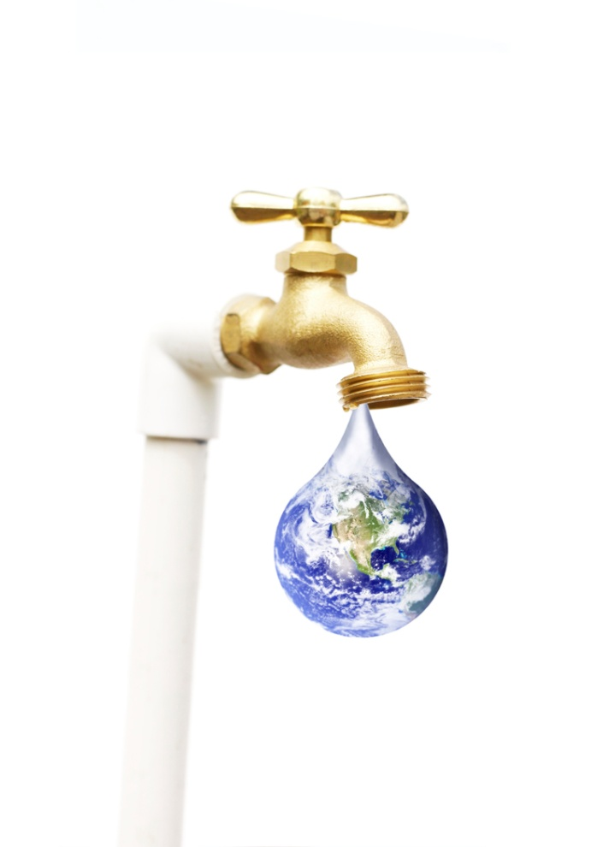
Section 2: Efficiency and Uniformity
What is the big deal?
Large volumes of wasted water
Increased water bills
Increased demand on the resource
Water supply is limited!
Photo credit: Microsoft Clip Art
Notes:
Clip art

Slide 6
Section 2: Efficiency and Uniformity
Components of Efficiency
Even application
Wind drift
Broken equipment
Equipment not adjusted properly
Separation of plant materials with different water requirements
Pressure

Slide 7
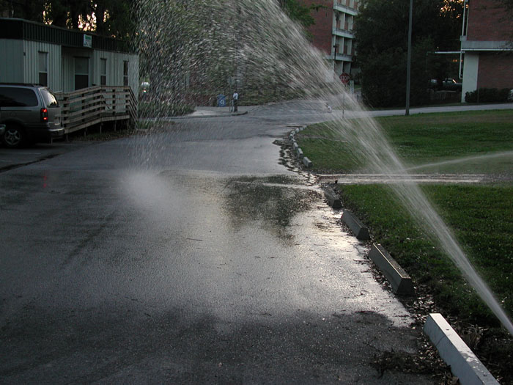
Section 2: Pop Quiz – Is this efficient?
Photo credit: Michael D. Dukes
Notes:
Taken from Dr. Dukes’ presentation

Slide 8
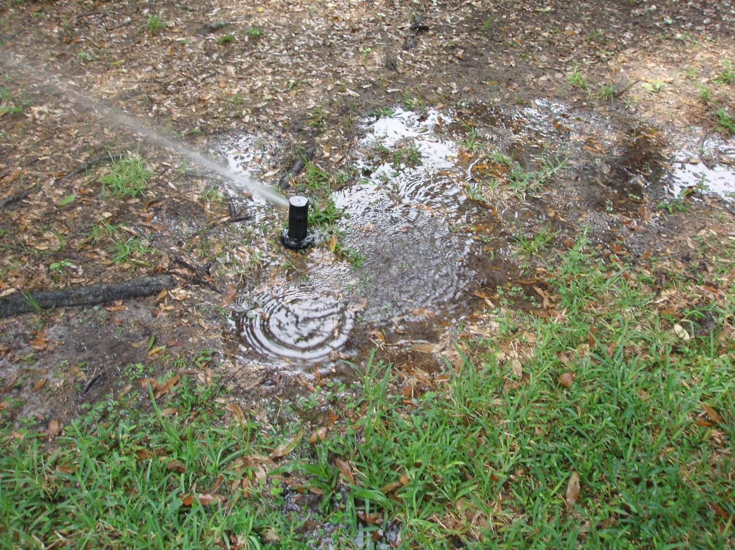
Section 2: Pop Quiz – Is this efficient?
Photo credit: Stacia L. Davis
Notes:
I took this photo at an ET controller home in Hillsborough County during an audit.

Slide 9
Section 2: Efficiency and Uniformity
Over-irrigation = wasted water
Identify DRY and WET areas
Root
Zone
Notes:
Mary made this.

Slide 10
Section 2: Efficiency and Uniformity
Notes:
Melissa gave this to me

Slide 11
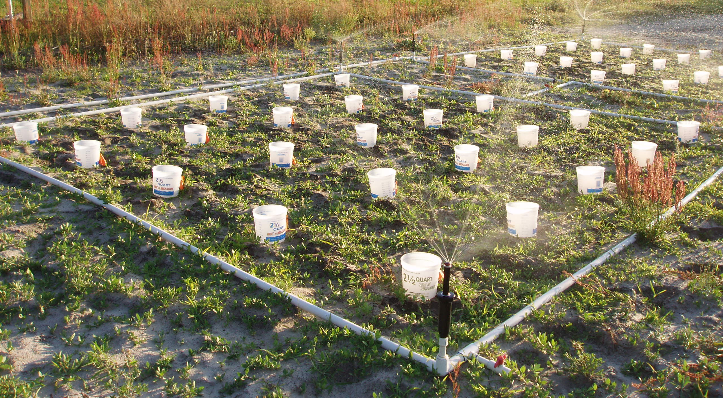
Section 2: Efficiency and Uniformity
How do you measure uniformity?
Photo credit: Stacia L. Davis
Notes:
I took this photo at the irrigation park.

Slide 12
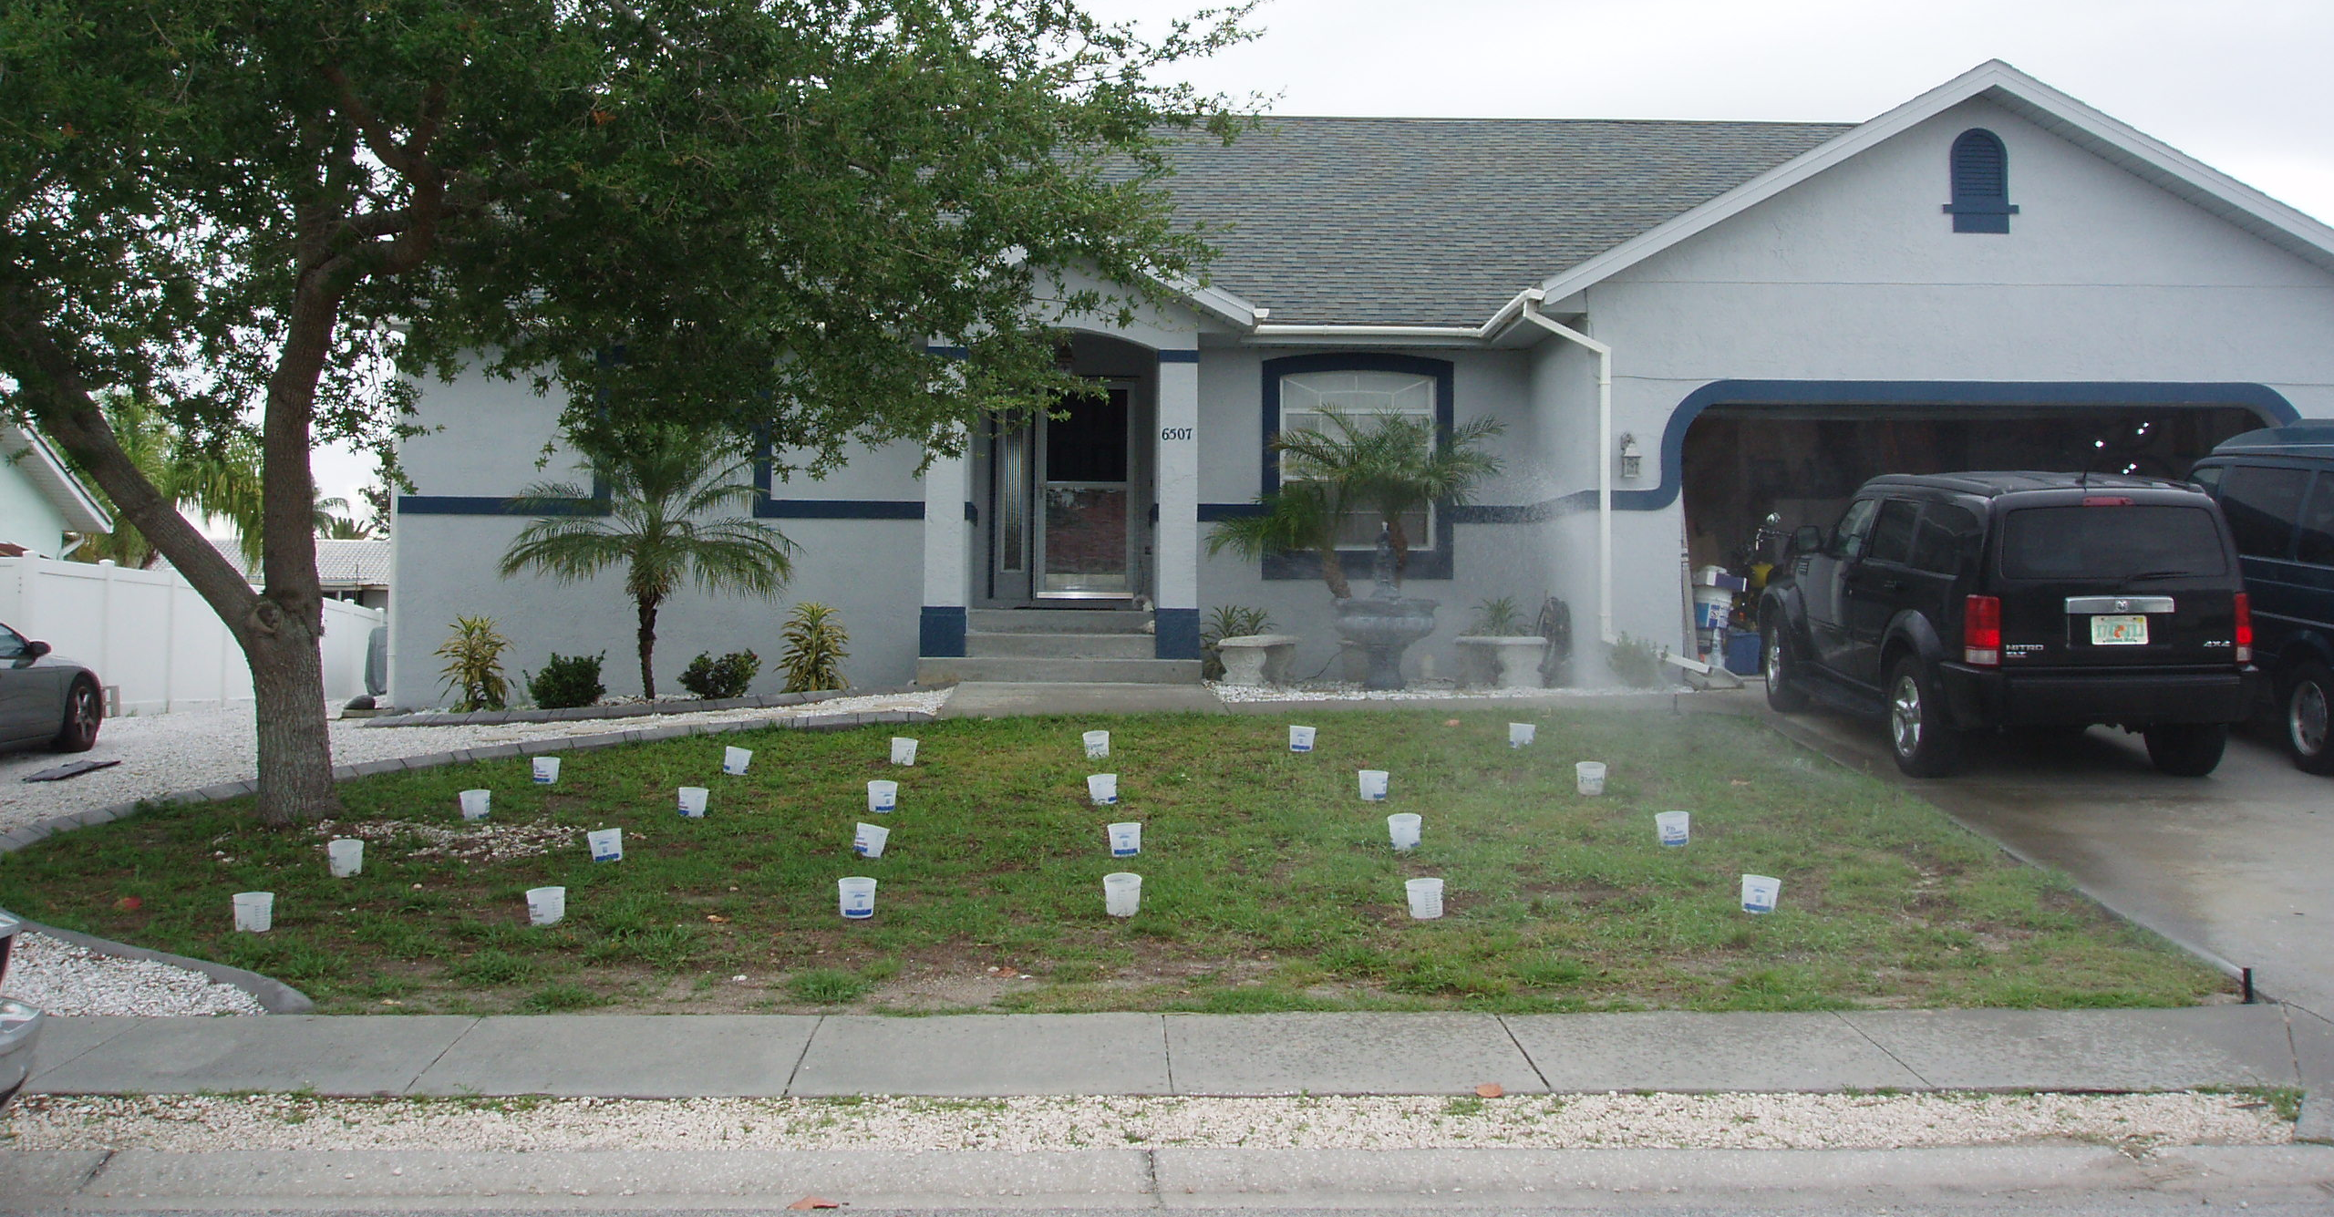
Section 2: Efficiency and Uniformity
How do you measure uniformity?
Photo credit: Stacia L. Davis
Notes:
I took this photo of a homeowner we considered for the ET controller study in Hillsborough County.

Slide 13


Section 2: Calculating Uniformity
Low Quarter
Arranged by increasing depth collected
Average = 0.5 inches
Average = 0.8 inches
Notes:
IAEF presentation titled power point audit 9-8.

Slide 14
Section 2: Overview
Proper Design and Installation
Efficiency and Uniformity
Sprinkler Spacing
Microirrigation layout
Pressure
Piping and Wiring

Slide 15
Section 2: Sprinkler Spacing
Spacing types
  Square
  Triangular
Head-to-Head coverage

Slide 16
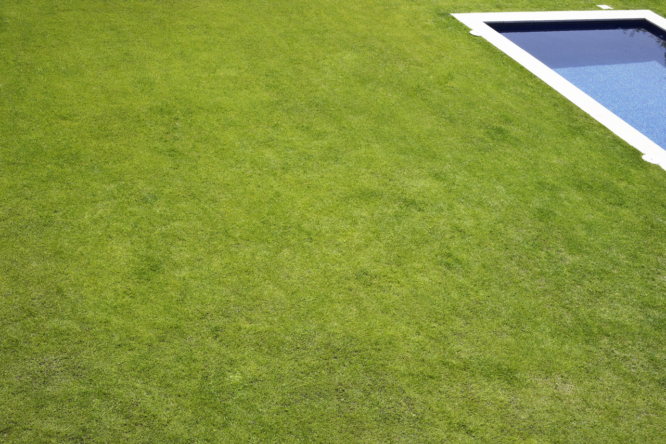
Section 2: Sprinkler Spacing
Spacing type:
Square
Photo credit: Microsoft Clip Art
R
R
Notes:
Clip art

Slide 17
Section 2: Sprinkler Spacing
Spacing type:
Triangular
Photo credit: Microsoft Clip Art
Notes:
Clip art

Slide 18
Section 2: Overview
Proper Design and Installation
Efficiency and Uniformity
Sprinkler Spacing
Microirrigation layout
Pressure
Piping and Wiring

Slide 19
Section 2: Microirrigation Layout
Sometimes called “Low Volume Irrigation”
Targets root ball of plant being watered
Most efficient type of irrigation
Decreases water loss from ET, wind, and runoff
Minimizes the following problems
            Pests
            Weeds
            Disease
            Erosion
Notes:
Picture from: http://www.earth-systems.co.uk/catalog/index.php?main_page=index&cPath=75

Slide 20
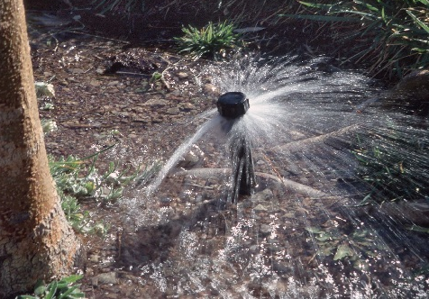
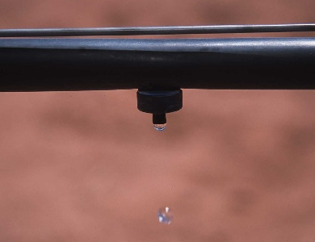
Section 2: Microirrigation Layout
Emitter Types
  In-line tubing
  Drip emitters
  Micro-sprays
  Bubblers
Photo by Lynn Betts, USDA NRCS
Photo by Jeff Vanuga, USDA NRCS
Notes:
In-line tubing, bubbler, and drip emitter at: rainbird.com
Micro-spray unable to locate origin.

Slide 21
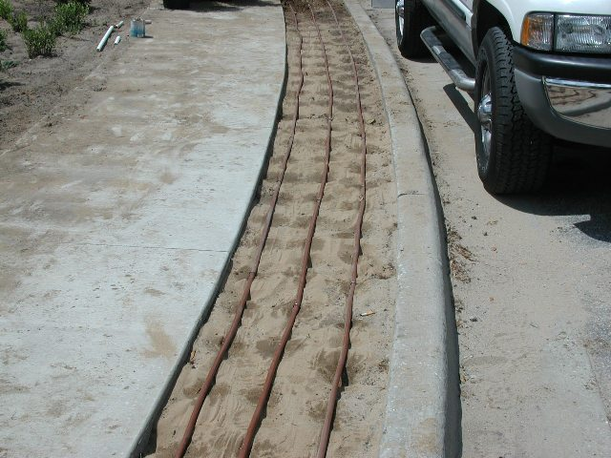
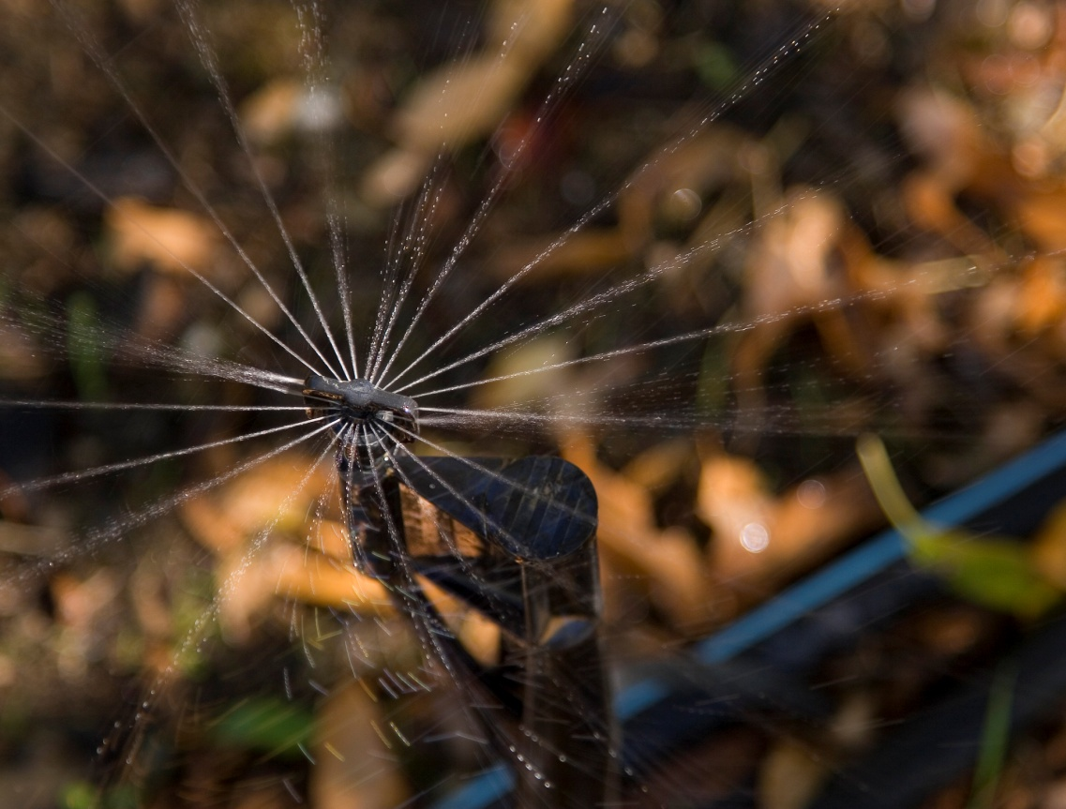
Section 2: Microirrigation Layout
Photo credit: Michael D. Dukes
Photo courtesy of USDA NRCS
Notes:
Upper Right – Dr. Dukes’ presentation
Lower left – unable to locate origin

Slide 22
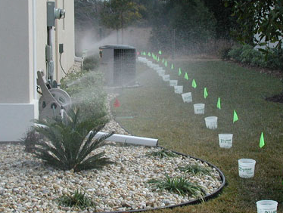
Section 2: Pop Quiz – Is this efficient?
Photo credit: Michael D. Dukes
Notes:
From Dr. Dukes’ presentation

Slide 23
Section 2: Overview
Proper Design and Installation
Efficiency and Uniformity
Sprinkler Spacing
Microirrigation layout
Pressure
Piping and Wiring

Slide 24
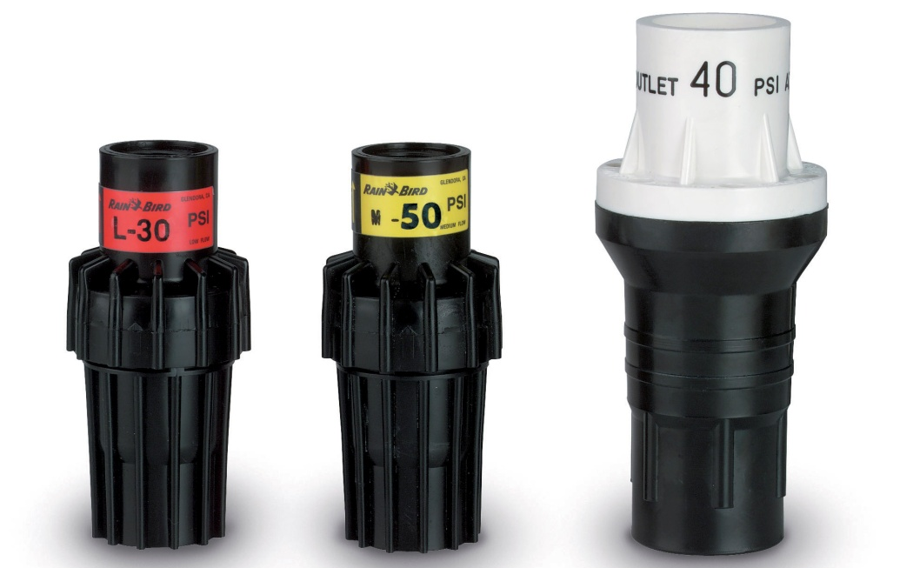
Section 2: Pressure
No more than 10% pressure loss through system
Photo credit: IAEF.org
Notes:
Pressure regulators:http://store.rainbird.com/shopexd.asp?id=695 also seen on other websites
Tech specs chart from rainbird.com

Slide 25
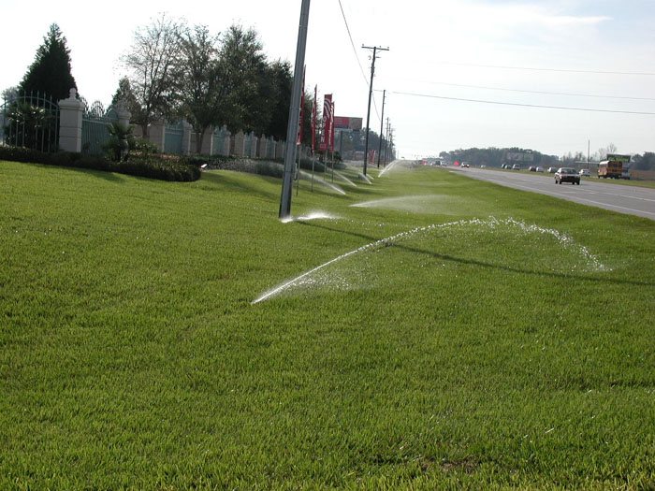
Section 2: Pop Quiz – Is this efficient?
Photo credit: Michael D. Dukes
Notes:
From Dr. Dukes’ presentation

Slide 26
Section 2: Overview
Proper Design and Installation
Efficiency and Uniformity
Sprinkler Spacing
Microirrigation layout
Pressure
Piping and Wiring

Slide 27
Section 2: Piping and Wiring
Piping should be sized to handle the maximum pressure of the source.
Piping should be buried ~ 3 feet below the soil surface. Generally, this does not happen in Florida.
Wiring should be run underneath the piping to avoid accidents.

Slide 28
Section 2: Pop Quiz – Is this efficient?
Photo credit: Michael D. Dukes
Notes:
From Dr. Dukes’ presentation

Slide 29

Questions?
Photo credit: Microsoft Clip Art

