Slide 1
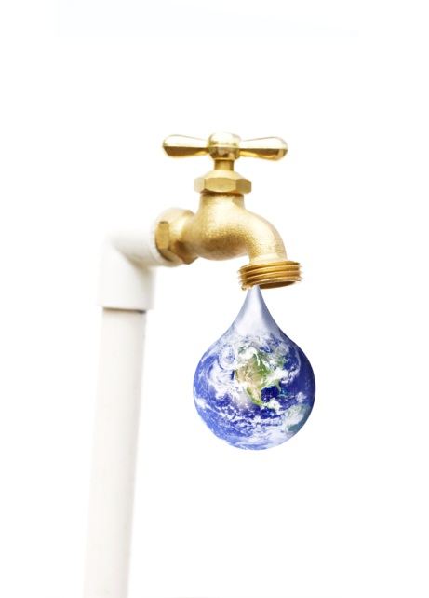

The Truth About Hydration

Slide 2
Learning Objectives
To identify the water requirements of healthy adults
To list the inputs and outputs of water balance in healthy adults
To describe the dietary sources of water
To describe common abnormal fluid and electrolyte conditions.

Slide 3

Thirsty?
Notes:
Do you feel thirsty? Thirst is the most important regulator of water intake.

Slide 4
Total Body Water
Men – about 60% water
Women – about 50% water
Infants – 70% water
Percent body water goes down as body fat goes up.
Most body water is in and around body cells with 4-5% in the blood.
Notes:
Most of us are made up of at least 50% water. Water is the most important nutrient. We can go without food for weeks possibly, but not water.

Slide 5
Water Needs
An absolute minimum is thought to be 1 ml/kcal, more than 1 cup for every 250 calories needed.
Average adult recommendations are 30-35 ml per kg of body weight.
Older adults - 25 ml per kg
That’s about 8-10 cups of water from all sources for a 150 lb. adult.

Slide 6
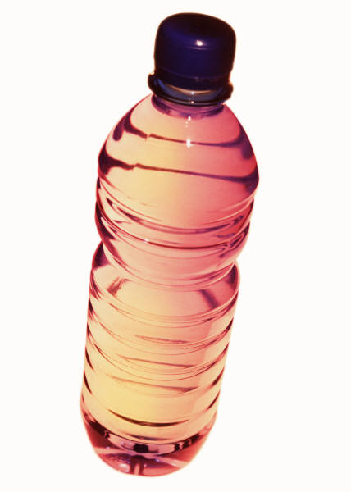
Dietary Reference Intakes (IOM)
Water Recommendations
Males 51-70 years = 3.7 L
Males >70 years = 3.7 L
Females 51-70 years = 2.7 L
Females >70 years = 2.7 L
About 15 cup/day for men
About 11 cups/day for women

Slide 7
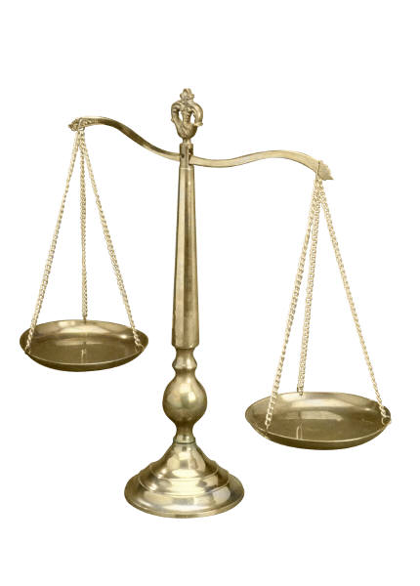
Fluid Intake vs Output
Fluid Intake
Fluid Output
Liquids 5 cups
Solid Food 4 cups
Metabolic water 1+ cups
Total 10 cups
Feces < 1 cup
Urine 6 cups
Sweat >½ cup (varies!)
Lungs ½ to 1 cup
Non-sweating skin 1 cup
Total 10 cups

Slide 8
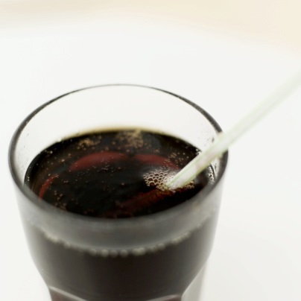
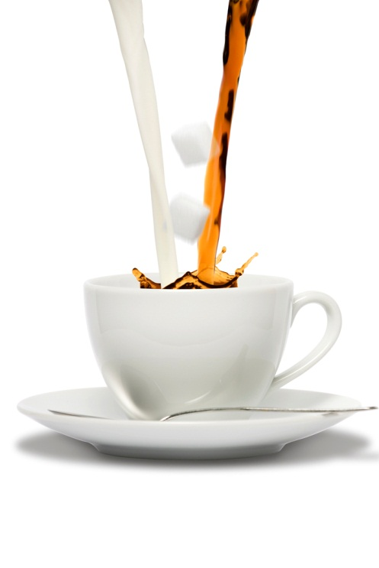
Beverages – a good source of water
Beverage | % water
Cola, regular | 90
Milk 2% | 87
Orange juice | 87
Coffee | 98

Slide 9
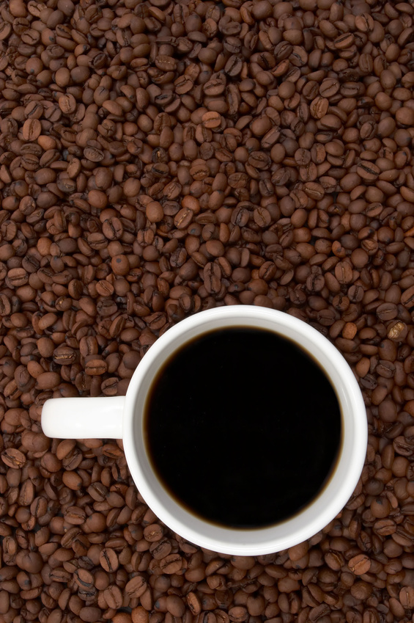
What about coffee and tea?
“My health care provider told me that because coffee and tea contain caffeine, they don’t count toward my fluid intake. Is this true?”

Slide 10
What about coffee and tea?
Caffeine does not cause more fluid to be lost from the body than the caffeinated beverage itself provides.
Caffeine causes a bit more fluid to be excreted (as urine) in the short term (a day) compared to plain water but does not effect on overall hydration.
When used in people who are exercising regularly, even when exercising in hot, humid conditions, caffeinated beverages provide fluid for rehydration and do not contribute to dehydration.

Slide 11
Many foods provide water!
Dairy Foods | % Water | Meat/Alternates | % Water
Cottage cheese | 79 | Bologna | 56
Sour cream | 80 | Lean beef | 60
Ice cream | 67 | Cod broiled | 65
Milkshake | 83 | Ham boiled | 59
Pudding | 69 | Pork chop | 53
Yogurt plain | 85 | Chicken roast | 71
Yogurt flavored | 74 | Lentils/drained | 69
Scrambled eggs | 76 | Peanut butter | 2

Slide 12
Fruits/Veg. | % water | Breads/Cereals | % water
Beets cooked | 91 | Saltine cracker | 4
Carrots cooked | 91 | Bread, white | 35
Cauliflower,cooked | 93 | Cake, angel food | 34
Peas, cooked | 82 | Brownie | 10
Potatoes, mashed | 83 | Sandwich cookie | 2
Squash, mashed | 81 | Pasta, cooked | 72
Ketchup | 94 | Other
Applesauce | 76 | Jello® | 84
Banana | 76 | Creamed soup | 83
Orange | 86 | Caramilk bar | 8
Watermelon | 93 | Stew | 82

Slide 13
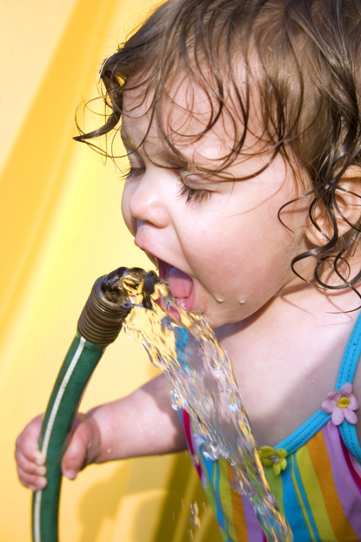
Regulation of Fluid and Electrolytes
Thirst
  Triggered by hypothalamus in brain
  Increases fluid intake
Kidneys
  Regulate urine production and thus, body water
  Urine can be very concentrated or very dilute

Slide 14
Disorders of Fluid Balance
Can be changes in:
  Fluid volume
  Concentration of electrolytes
Typically occur together

Slide 15
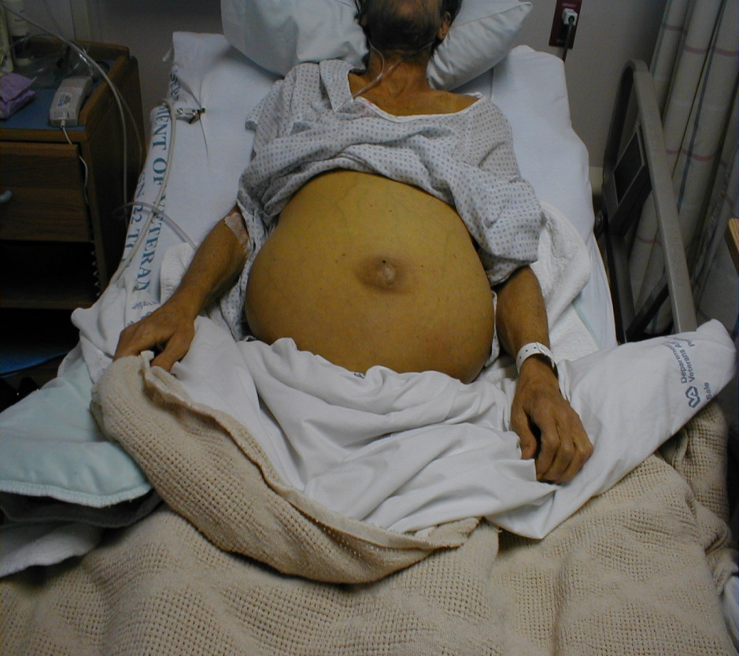
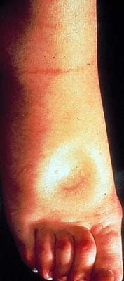
Abnormal fluid accumulation
Ascites
Edema

Slide 16
Disorders of Fluid Balance
Hypovolemia (low body water)
Causes:
  Diarrhea
  Vomiting
  Sweating (12 x 8 oz/hr max)
  Decreased intake
  Fistulas, wounds
  Ascites
  Diuresis (certain medications)
  Uncontrolled diabetes

Slide 17
Disorders of Fluid Balance
  Symptoms of Hypovolemia:
  Orthostatic hypotension (low blood pressure on standing)
  Tachycardia (fast heart rate)
  Weak pulse
  Dizziness
  Dry skin
  Poor skin turgor
  Rapid weight loss
  Dark urine
  Treatment: restore fluid – oral or IV

Slide 18
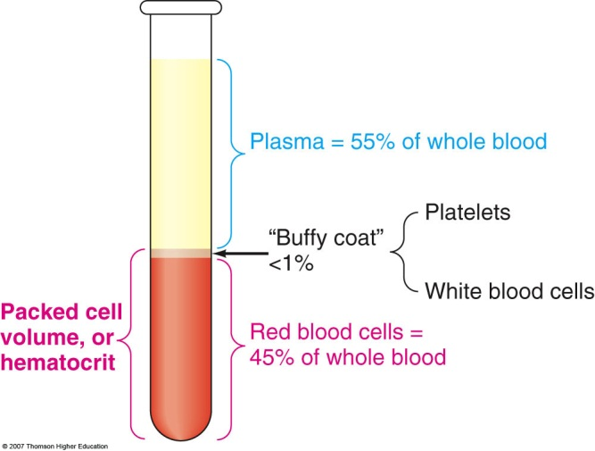
Disorders of Fluid Balance
Hypervolemia (high body water)
  Acute kidney disease
  Excess IV fluids
  Excess vasopressin (antidiuretic hormone – old term)
  Symptoms:
  Edema
  Elevated blood pressure
  Respiratory rales (rattles, crackles)
  Dilution of blood values
  Treatment:
  treat cause
  sodium and fluid restriction

Slide 19
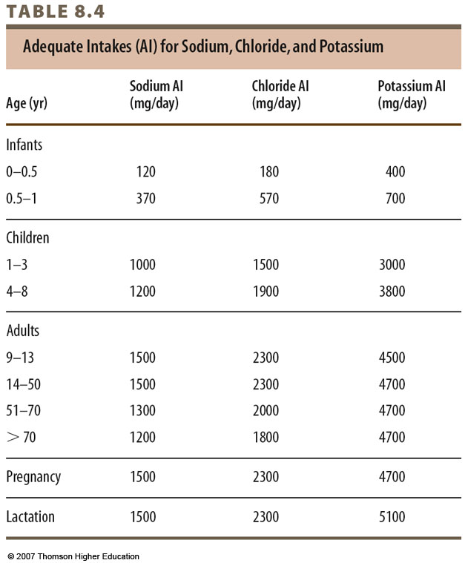

Slide 20
Disorders of Fluid Balance
Sodium imbalances
Hyponatremia (low blood sodium)
  Due to:
  Salt restriction with diuretics
  Water intoxication – too much water consumed
  Hyperglycemia (high blood sugar)
  Symptoms:
  Nausea/Vomiting
  Lethargy, Confusion
  Treatment:
  Restrict water

Slide 21
Water Intoxication
Hyponatremia, also called water intoxication, is generally the result of drinking excessive amounts of plain water which causes a low concentration of sodium in the blood.
Updated 1/13/2007 10:24:31 PM ET2007-01-14T03:24:31
SACRAMENTO, Calif. — A woman who competed in a radio station’s contest to see how much water she could drink without going to the bathroom died of water intoxication, the coroner’s office said Saturday.
Jennifer Strange, 28, was found dead Friday in her suburban Rancho Cordova home hours after taking part in the “Hold Your Wee for a Wii” contest in which KDND 107.9 promised a Nintendo Wii video game system for the winner.

Slide 22
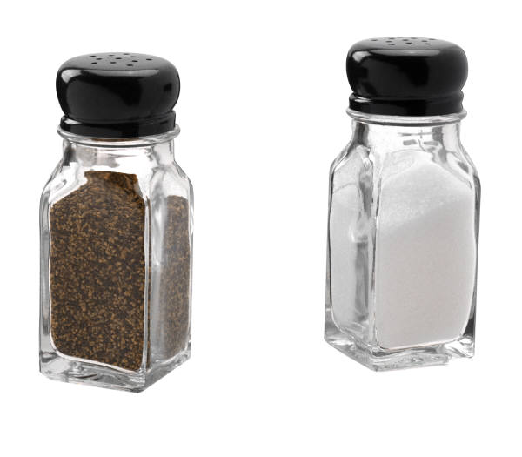
Disorders of Fluid Balance
Hypernatremia (high blood sodium)
  low water intake
  water loss
  Symptoms:
  lethargy and agitation
  Treatment:
  water intake or IV fluids

Slide 23
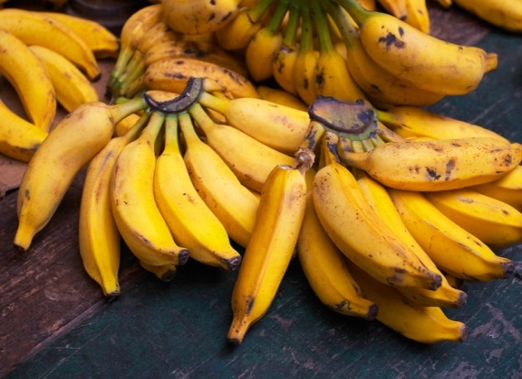
Disorders of Fluid Balance
Hypokalemia (low blood potassium)
Causes:
  Decreased intake
  Kidney loss – high urine output
  Gastrointestinal loss (e.g. vomiting)
  Diarrhea
  Loop diuretics e.g. Lasix
  Symptoms: muscle weakness, decreased reflexes, cardiac arrythmias (heartbeat irregularities)

Slide 24
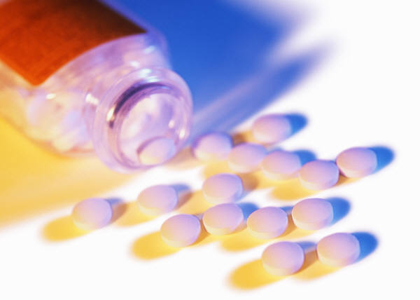
Disorders of Fluid Balance
Hyperkalemia (high blood potassium)
Causes:
  Kidney failure
  Potassium-sparing diuretics
  High breakdown of muscle tissue
  Potassium chloride tablets
  Symptoms:
  Muscle weakness, paralysis
  Paresthesis (abnormal skin sensations)
  Cardiac abnormalities
  Treatment:
  Medical intervention and low potassium diet/dialysis

Slide 25
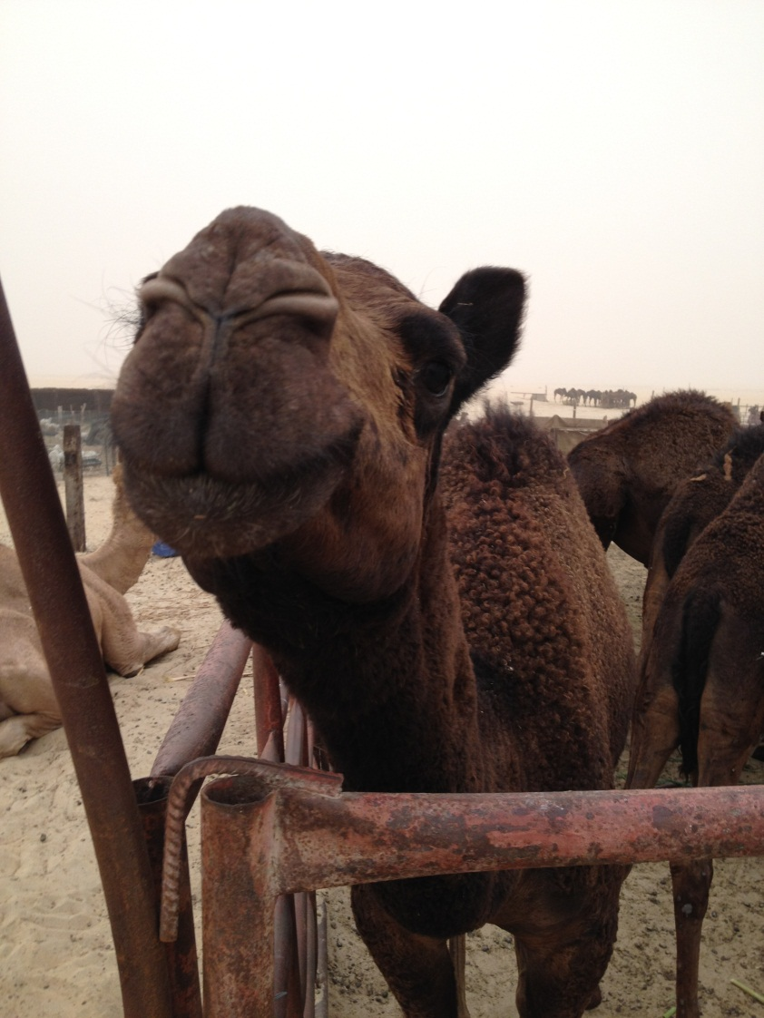
Fun Facts
How long can a camel go without water?
How much water can a camel drink?
Notes:
For weeks if they have greens to eat.
About 200 L or 50 gallons

Slide 26
References
Dietary Reference Intakes: Water, Potassium, Sodium, Chloride, and Sulfate - See more at: http://www.iom.edu/Reports/2004/Dietary-Reference-Intakes-Water-Potassium-Sodium-Chloride-and-Sulfate.aspx
Nelms M, Sucher KP, Lacey K, Long Roth S. Nutrition Therapy and Pathophysiology 2nd Ed. Thomson Brooks/Cole. 2011.

Slide 27
Credits
This presentation adapted for XXXXX county
and presented by:
Xxxxxxxx
Xxxxxxxx County Cooperative Extension Office
Xxxxxxxx phone number/address/email
This presentation prepared by:
Wendy J. Dahl PhD RD
Assistant Professor, FSHN
Extension Specialist
University of Florida
wdahl@ufl.edu

